Slide 1
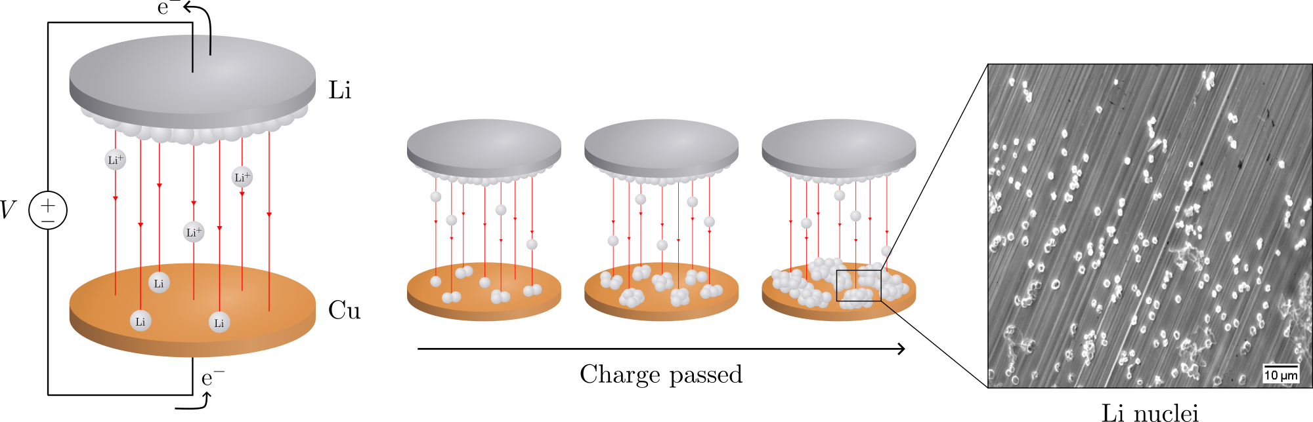
Electrochemical deposition of lithium on copper
Gottfrid Olsson
2024-05-29

Slide 2
PLAN: 25 minute presentation
Introduction:
Importance of batteries, improvements LMB>LIB (fig.), problems non-uniform growth (fig + in-depth), purpose of this thesis
Theory:
Homogenous nucleation theory; main results (fig.), how does eta impact r and N (fig.)?
Methods:
Cell assemblies (note importances; wave spring, no pressure); cycling protocol (fig.)
Results:
passivation of Cu; J-dep.; pressure (C-cell and T-cell, r & angle dep. and morphology)
Conclusion: 2 min
Passivation, J-dep. and pressure to achieve uniform deposition in LMBs
(Opposition and Questions from audience)

Slide 3
Introduction
Batteries
Lithium-ion battery very common type; you probably have it!
Lighter and smaller by replacing graphite in LIB with Li-metal

Slide 4
Batteries!
Opening: How many here have either a smartphone, a laptop, or a smartwatch?
Cool, then you are already fans of batteries, and you likely own at least one lithium-ion battery – a very common battery type
Say, would you like your device to be smaller, lighter, and have a longer battery life? Of course you would!
It’s easy, look: replace this graphite with Li and the cell increases its energy per weight and doubles the energy per volume – very nice!
Let’s use this battery. Oh… what’s happening? Without the graphite, Li gets deposited on the surface. The Li grows unevenly, and oh no – look – it reached the other side of the cell! It’s a short-circuit, and [thermal runaway] *BOOM* [cell explosion]
Yikes. Not good. Uneven deposition seems to be a problem.
There are in fact several problems.

Slide 5
Batteries!
250 Wh kg^{–1} to 440 Wh kg^{–1}
600 Wh L^{–1} to 1200 Wh L^{–1}
//LIB one of the most used batteries today
Looks like this.
If replace graphite with Li, increase specific energy and double the energy density
Would benefit e.g. electrical vehicles (extra range)
However, problems bcs. Li depos on surface! (n.s.)

Slide 6
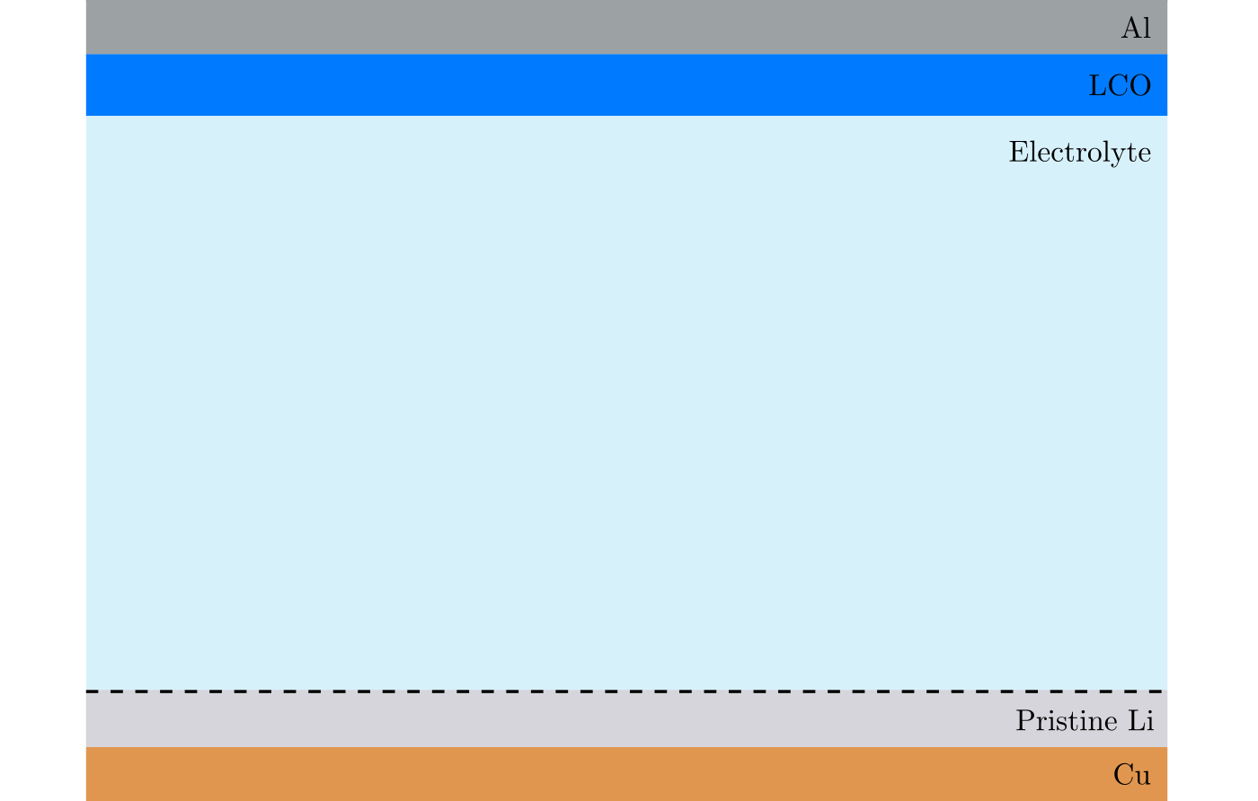
Non-uniform deposition problems

Slide 7
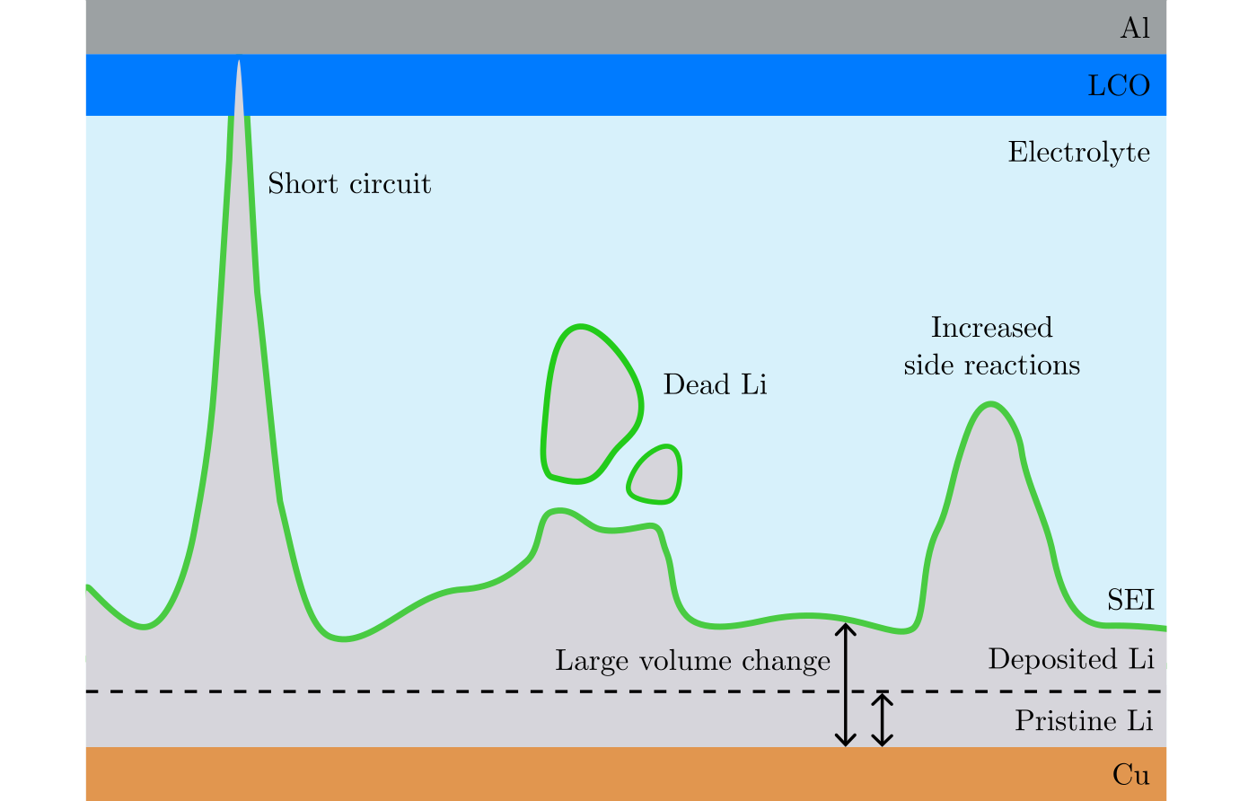
Non-uniform deposition problems

Slide 8
Purpose of this thesis
Investigate pressure, current, passivation

Slide 9
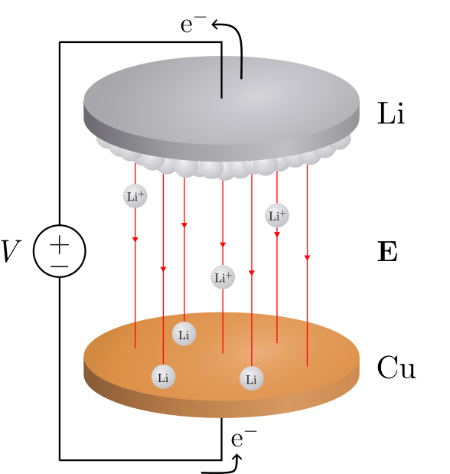
Deposition in a Li/Cu cell

Slide 10
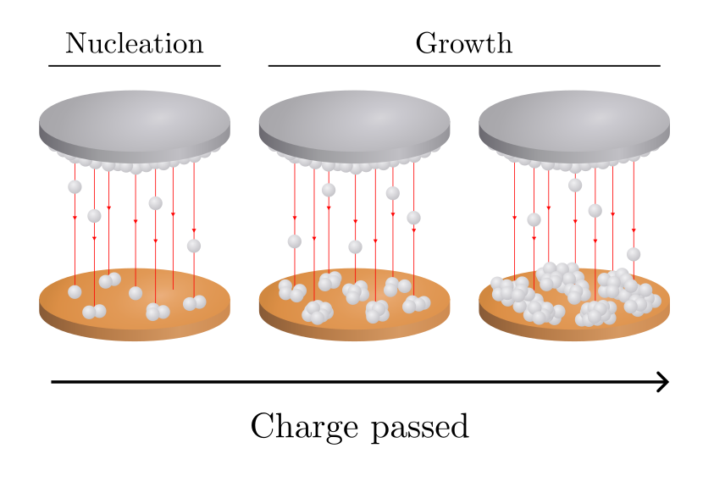
Deposition in a Li/Cu cell

Slide 11
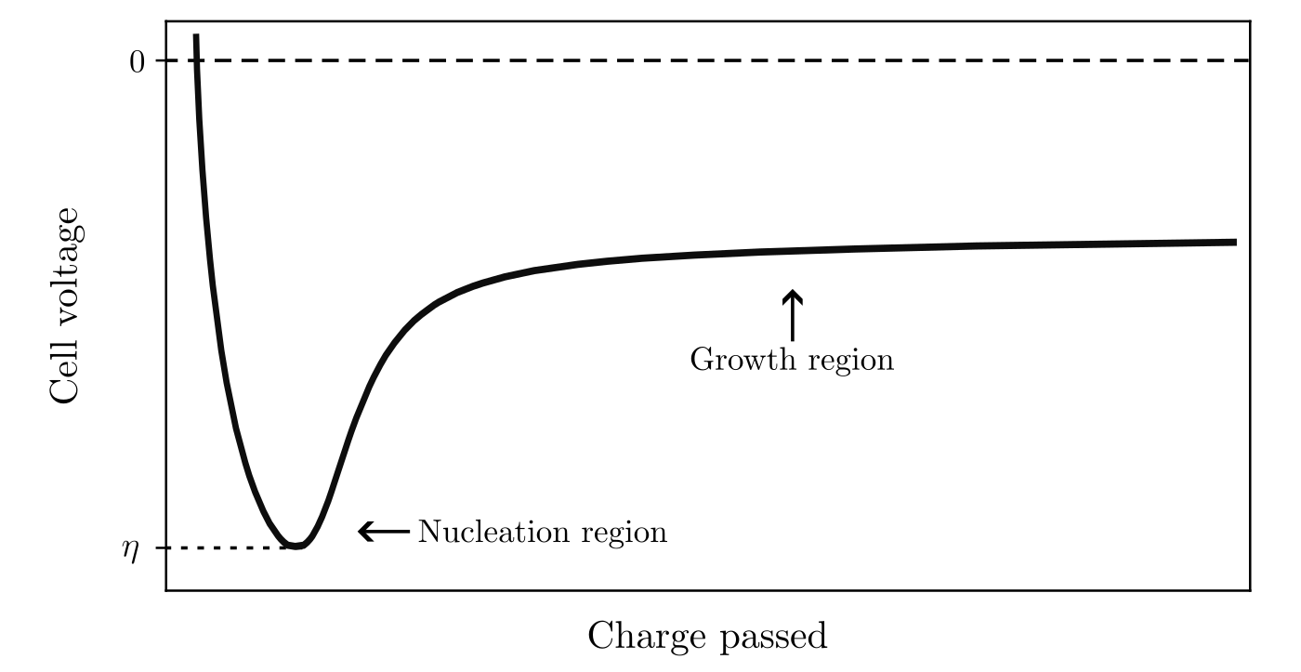
Deposition in a Li/Cu cell

Slide 12
Deposition in a Li/Cu cell

Slide 13
Deposition in a Li/Cu cell

Slide 14
Deposition in a Li/Cu cell

Slide 15
Deposition in a Li/Cu cell

Slide 16
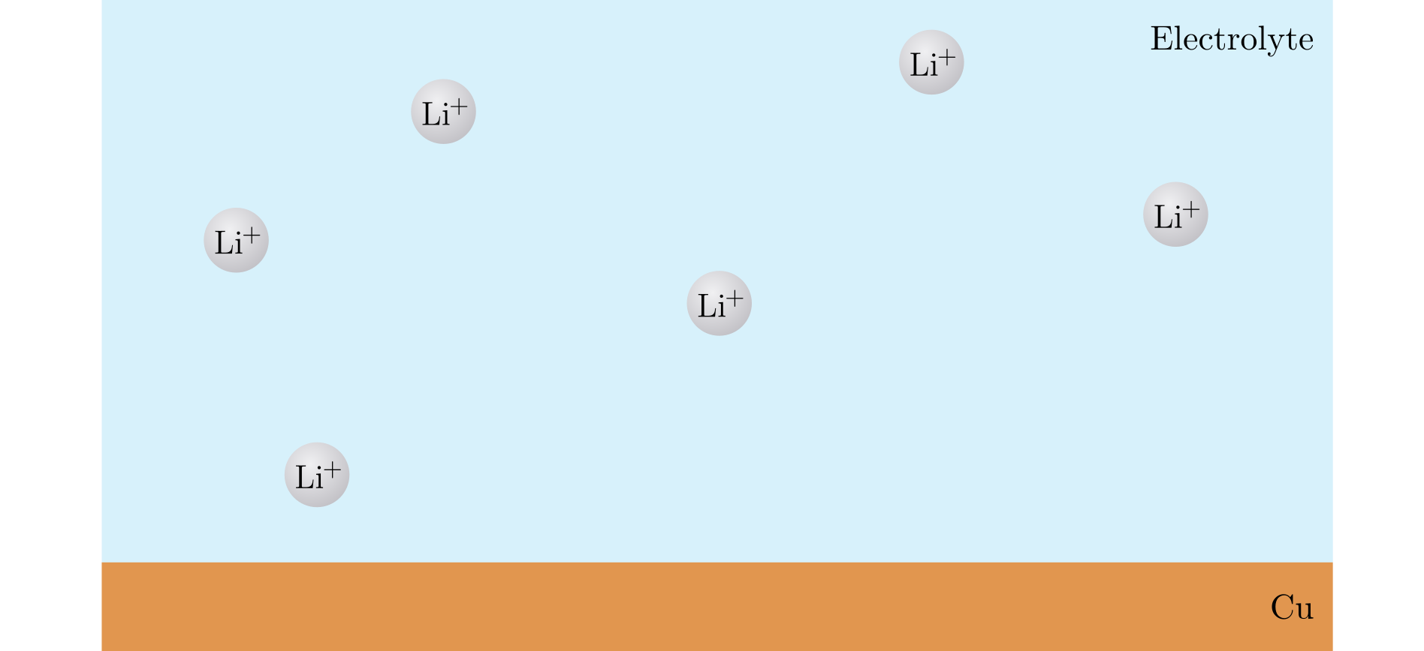
Nucleation
Notes:
Li-ions in solution (liquid) → Li-metal (solid)

Slide 17
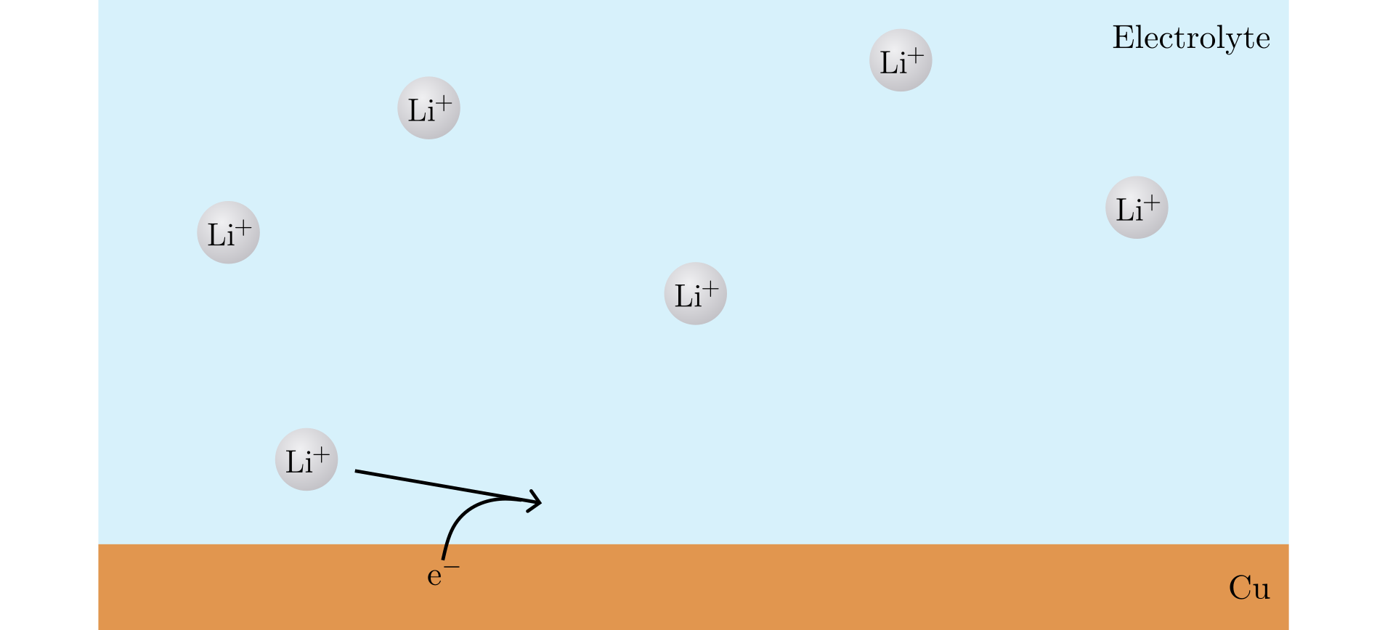
Nucleation

Slide 18
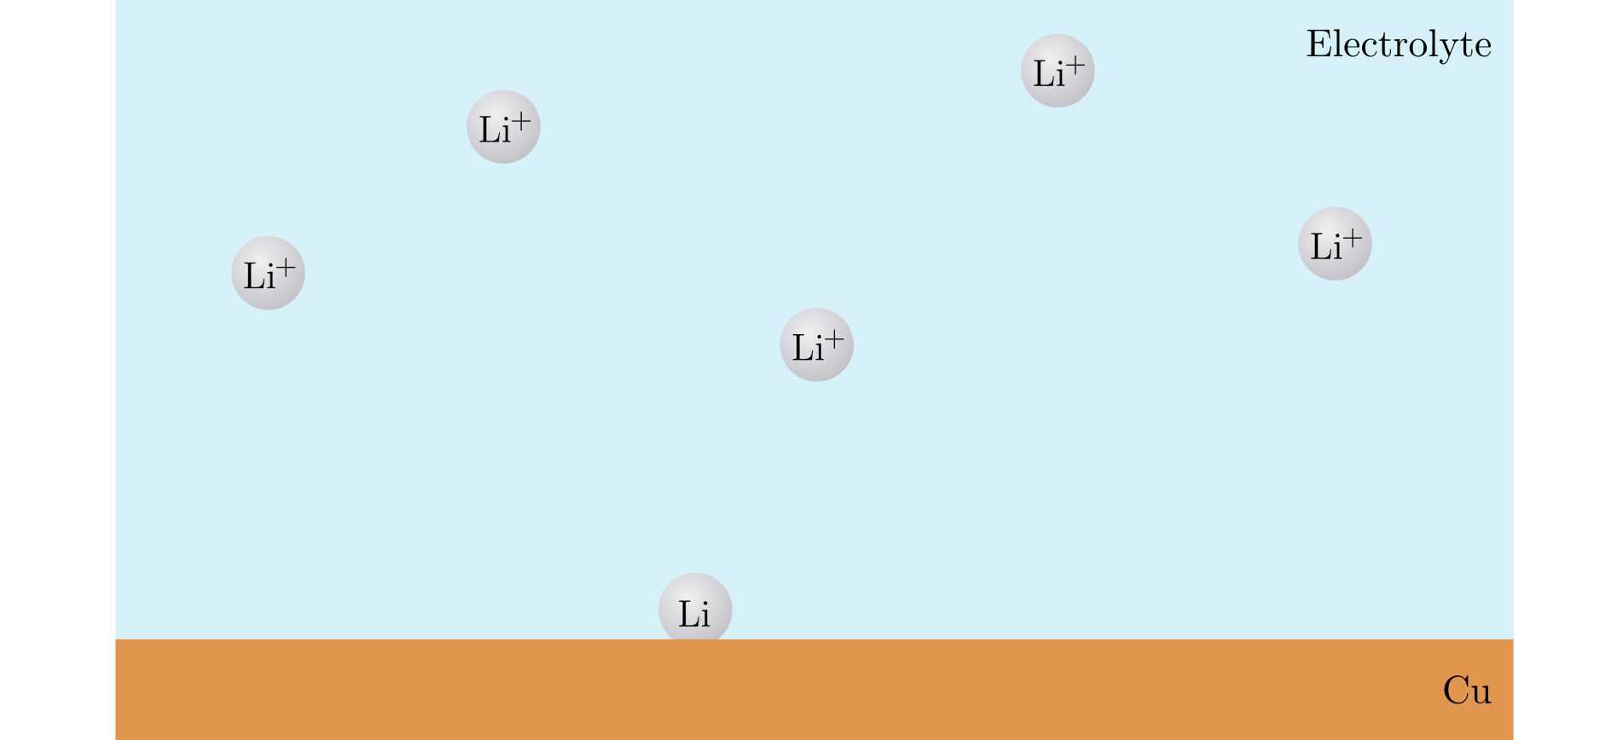
Nucleation

Slide 19
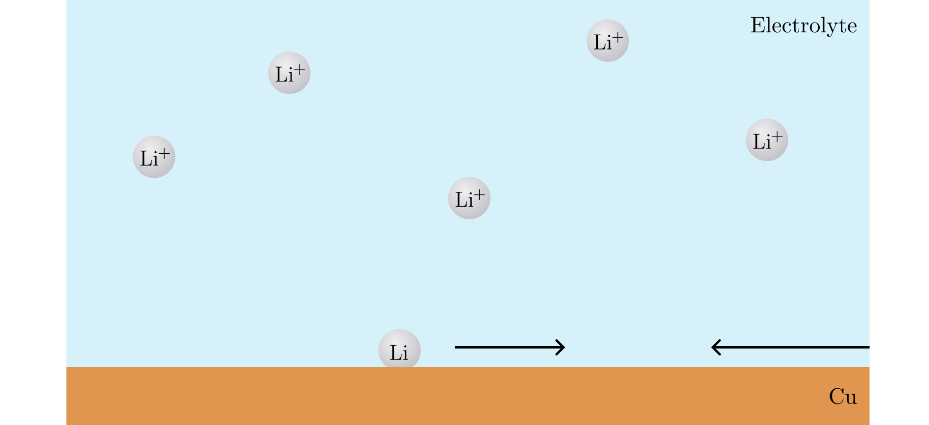
Nucleation

Slide 20
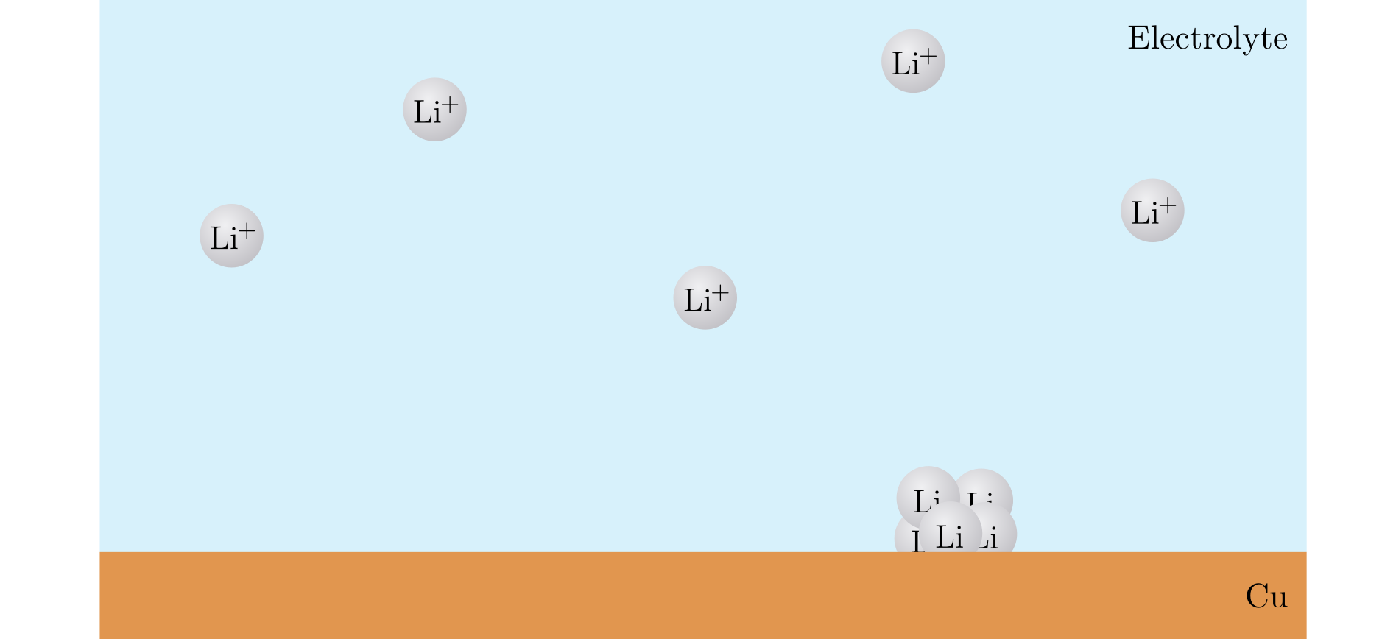
Nucleation

Slide 21
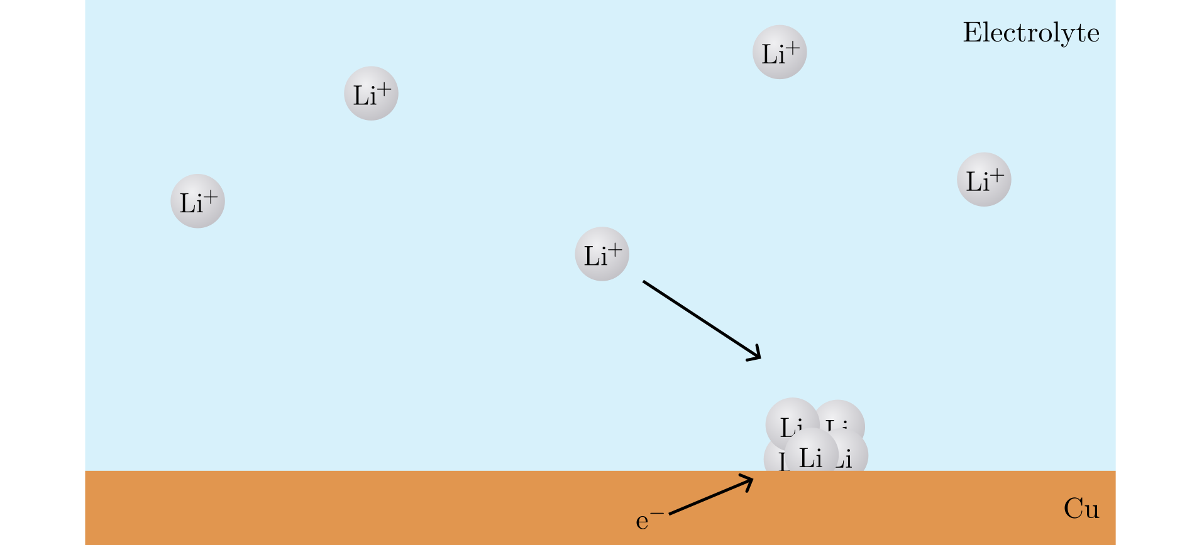
Nucleation

Slide 22
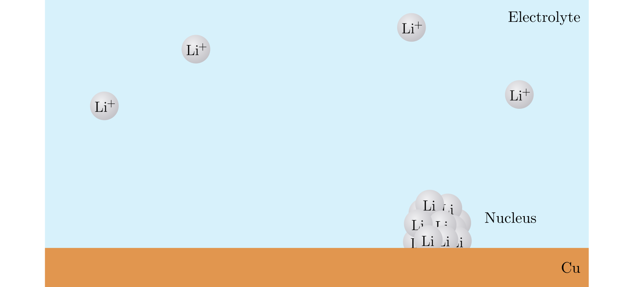
Nucleation

Slide 23
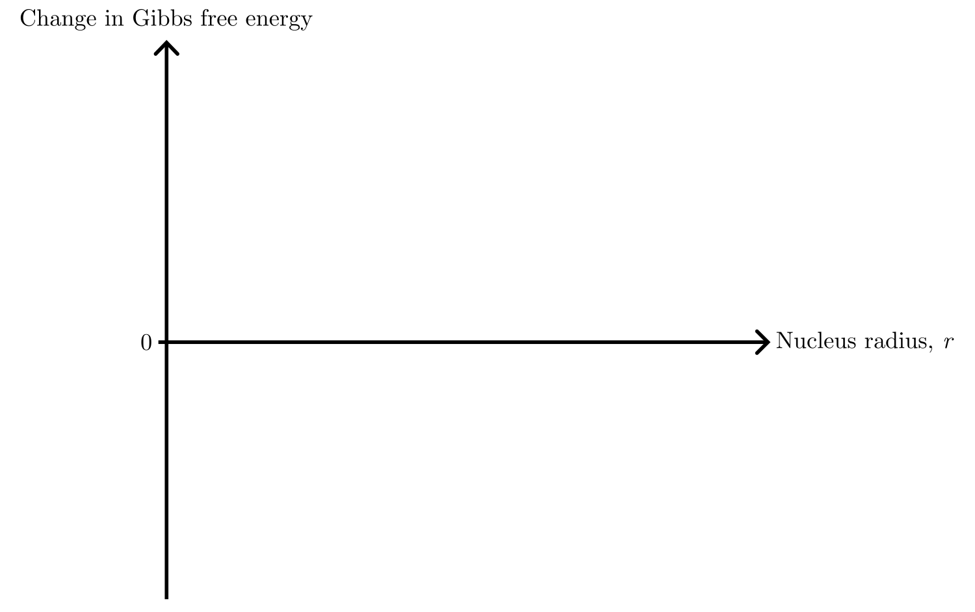
Nucleation theory

Slide 24
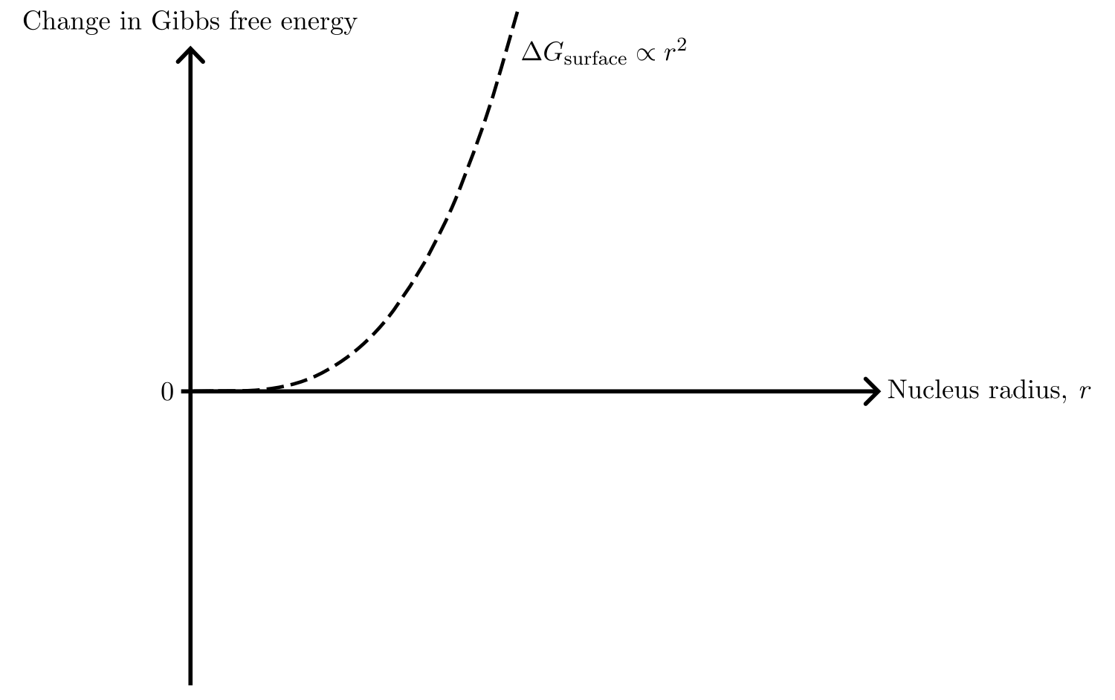
Nucleation theory

Slide 25
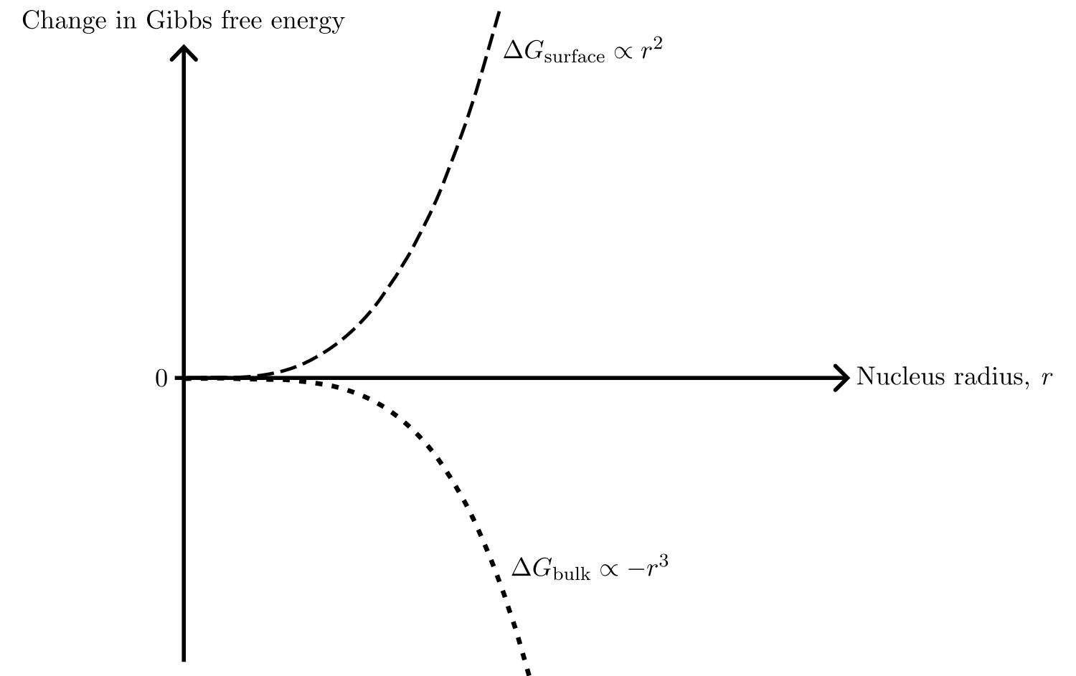
Nucleation theory

Slide 26
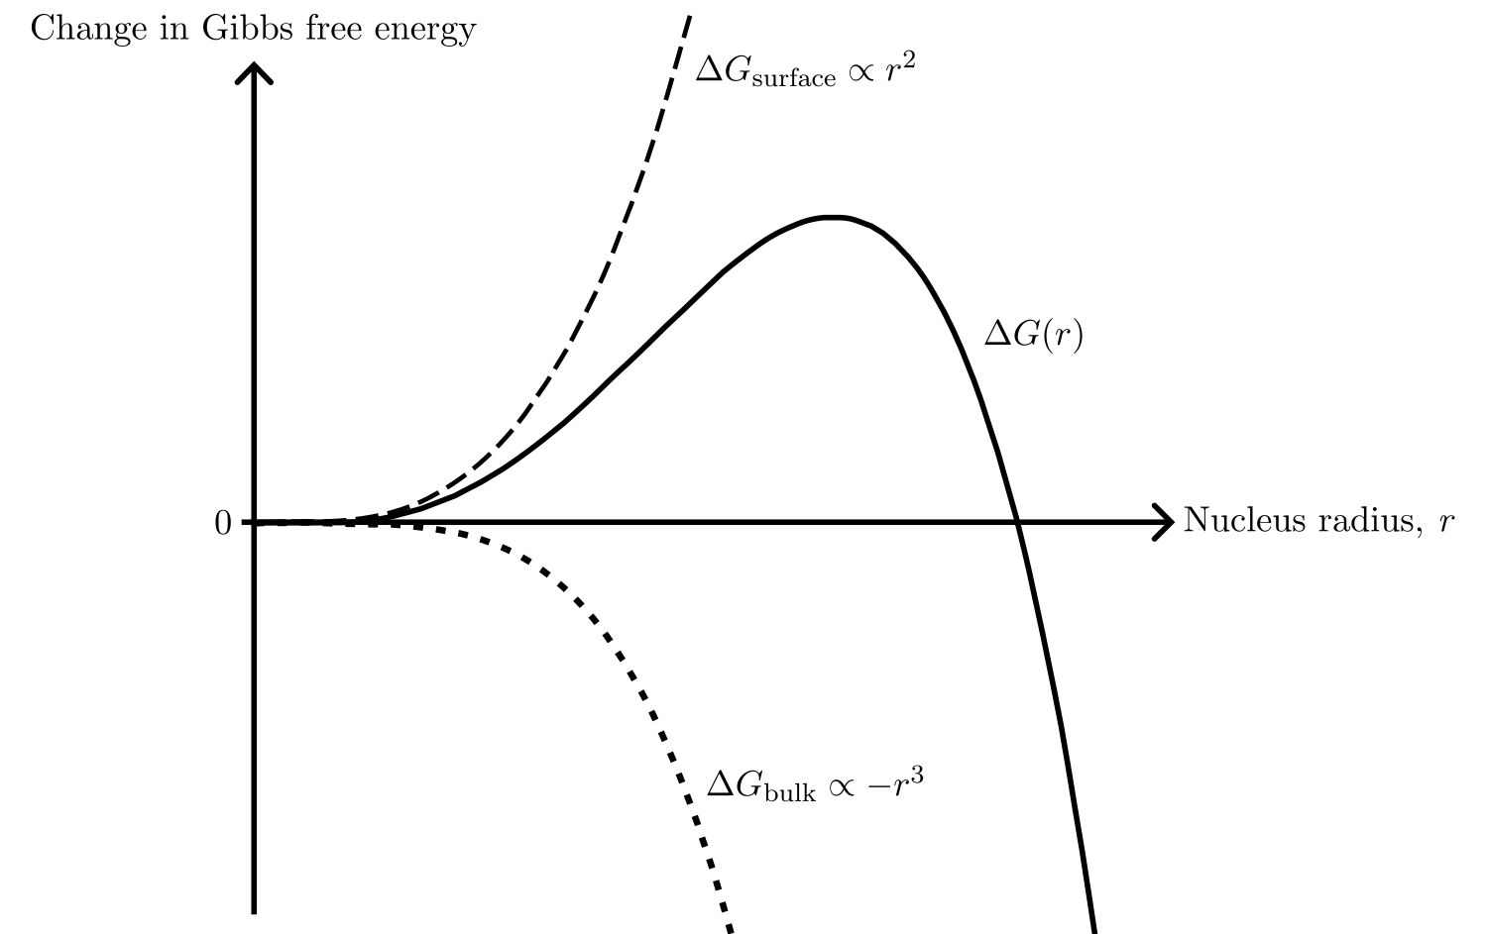
Nucleation theory

Slide 27
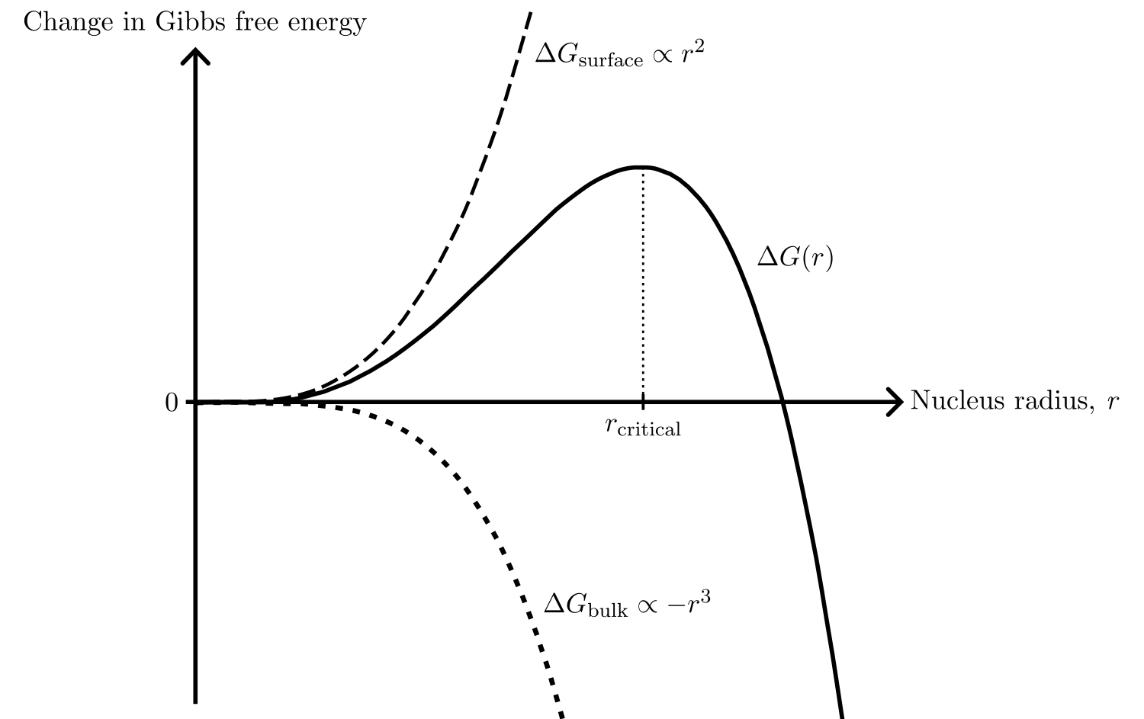
Nucleation theory

Slide 28
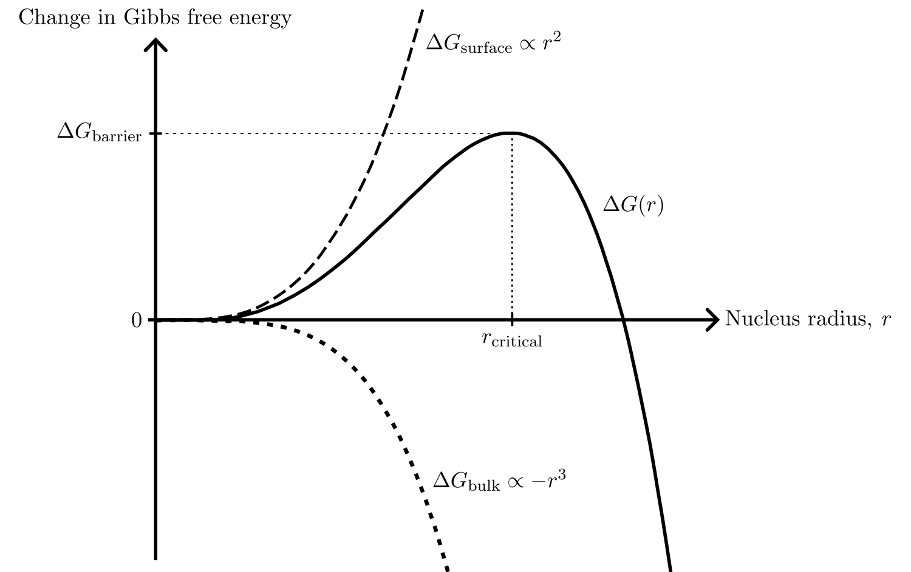
Nucleation theory

Slide 29
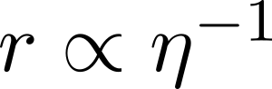
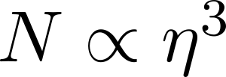
Nucleation theory

Slide 30
Nucleation theory

Slide 31
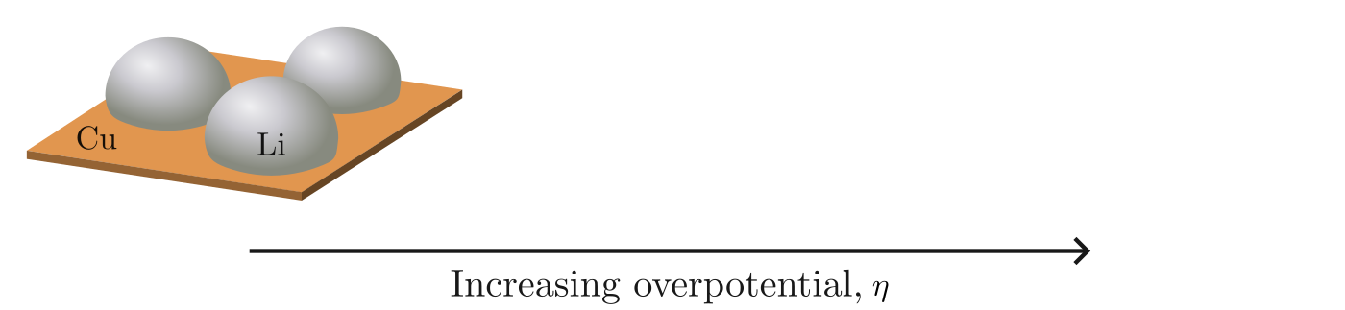
Nucleation theory

Slide 32
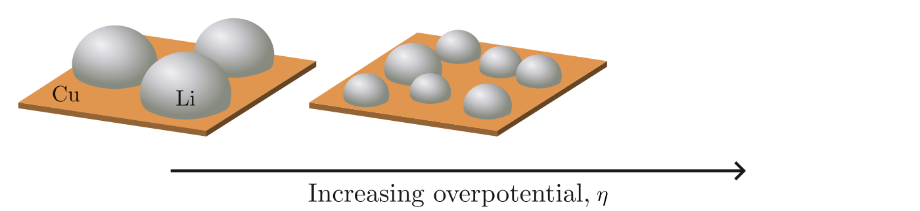
Nucleation theory

Slide 33
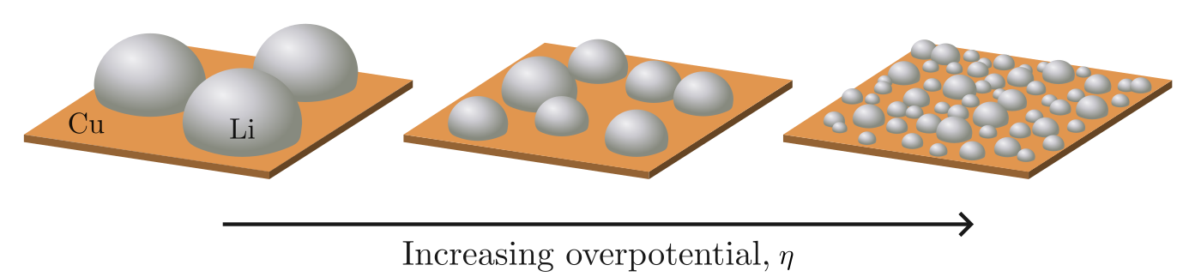
Nucleation theory

Slide 34
Specific scientific questions
The shape of the deposition curve
Degree of passivation of the Cu surface
Deposition current
Size and distribution of the nuclei
Pressure between the Li and Cu
Notes:
For different pressure, we need two different cell setups

Slide 35
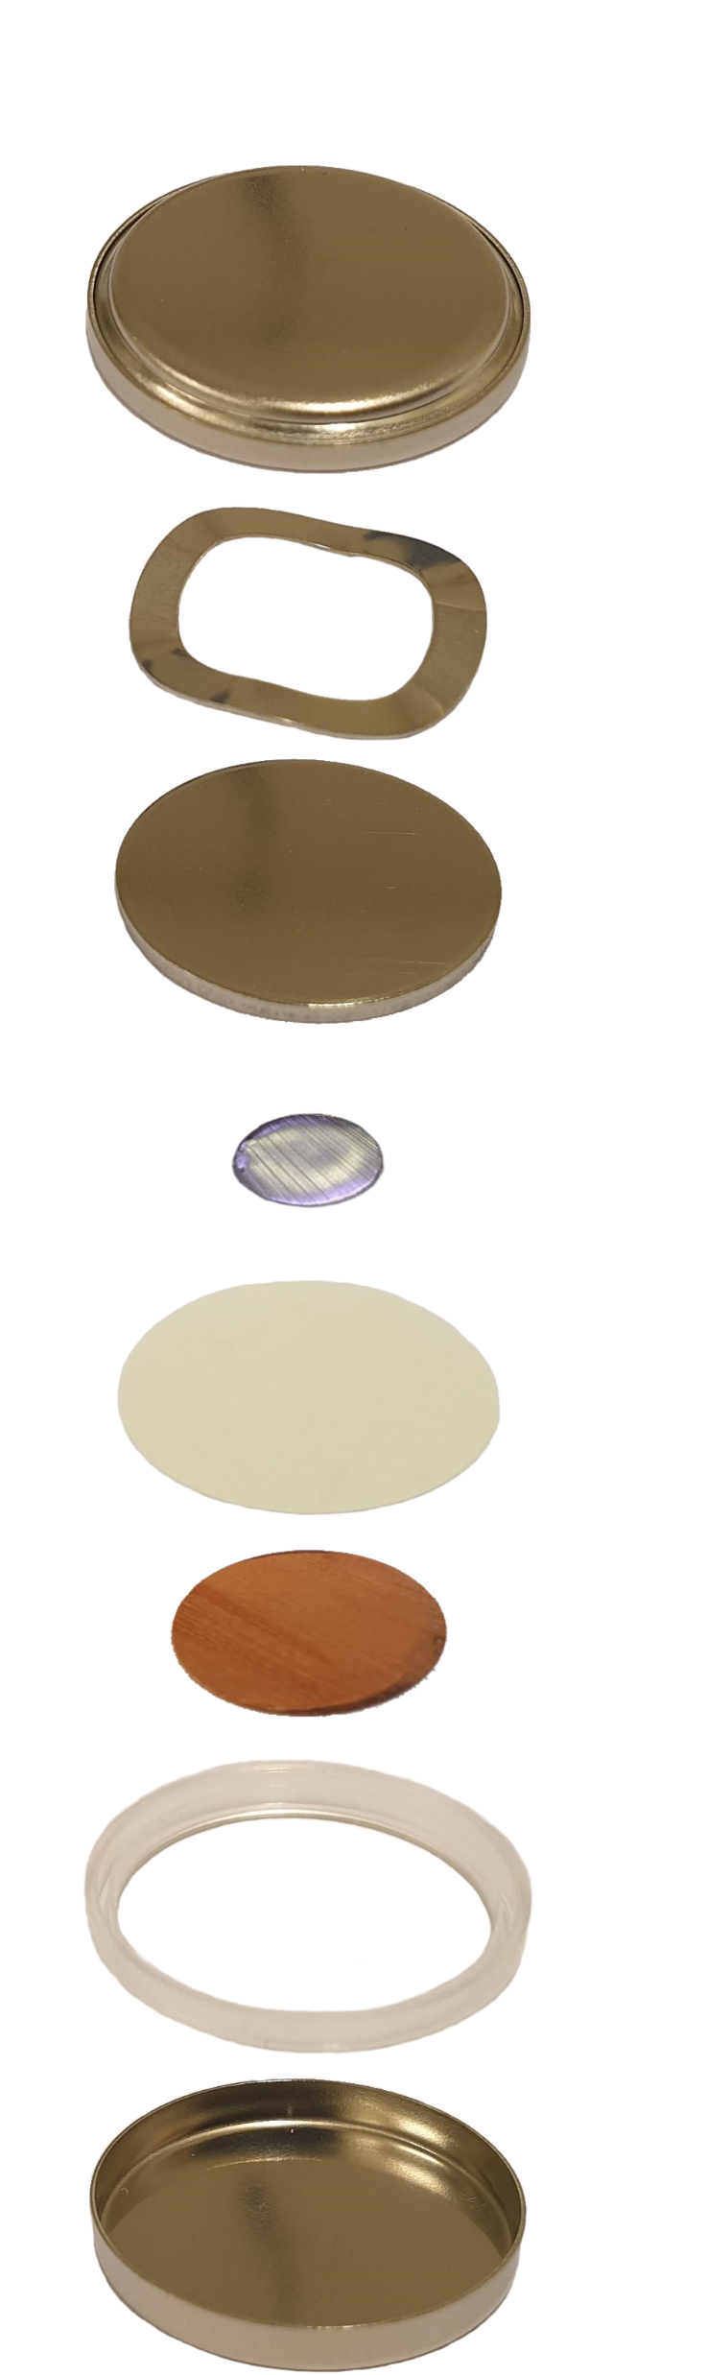
The C-cell
Cap
Spring
Spacer
Li
Separator
Cu
Gasket
Can

Slide 36
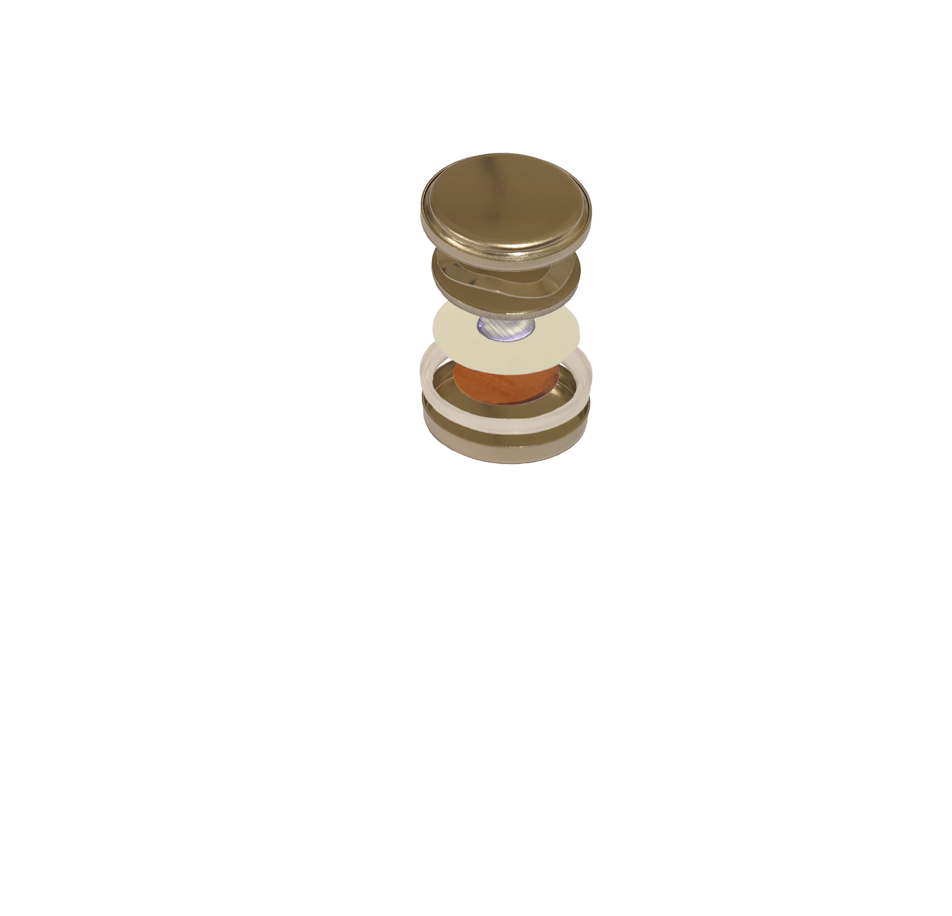
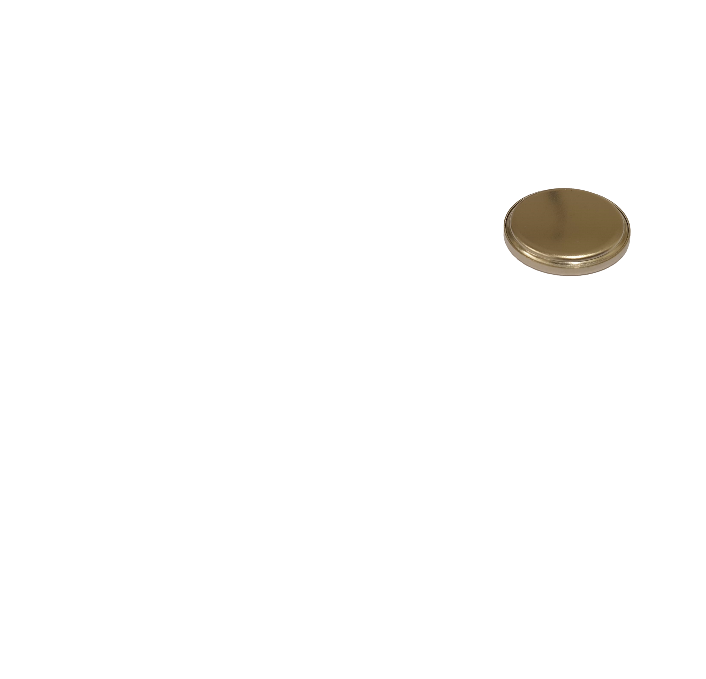
The C-cell
Cap
Spring
Spacer
Li
Separator
Cu
Gasket
Can

Slide 37
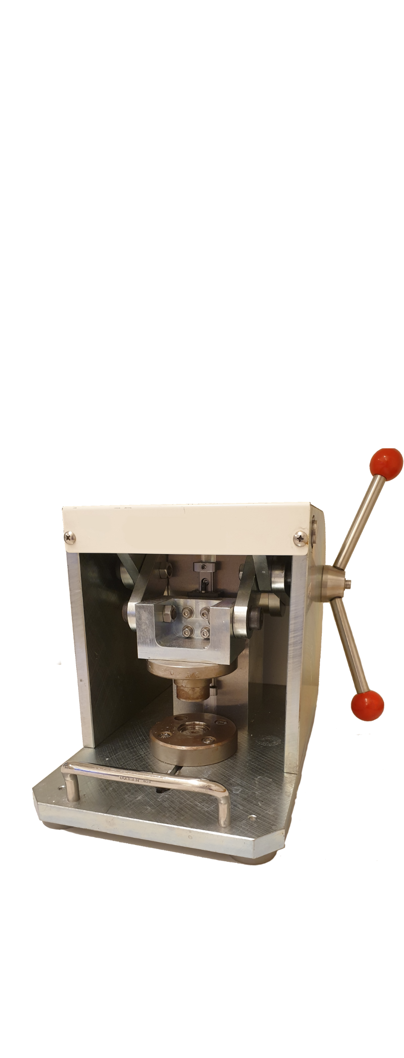
The C-cell
Cap
Spring
Spacer
Li
Separator
Cu
Gasket
Can

Slide 38

The C-cell
Cap
Spring
Spacer
Li
Separator
Cu
Gasket
Can

Slide 39
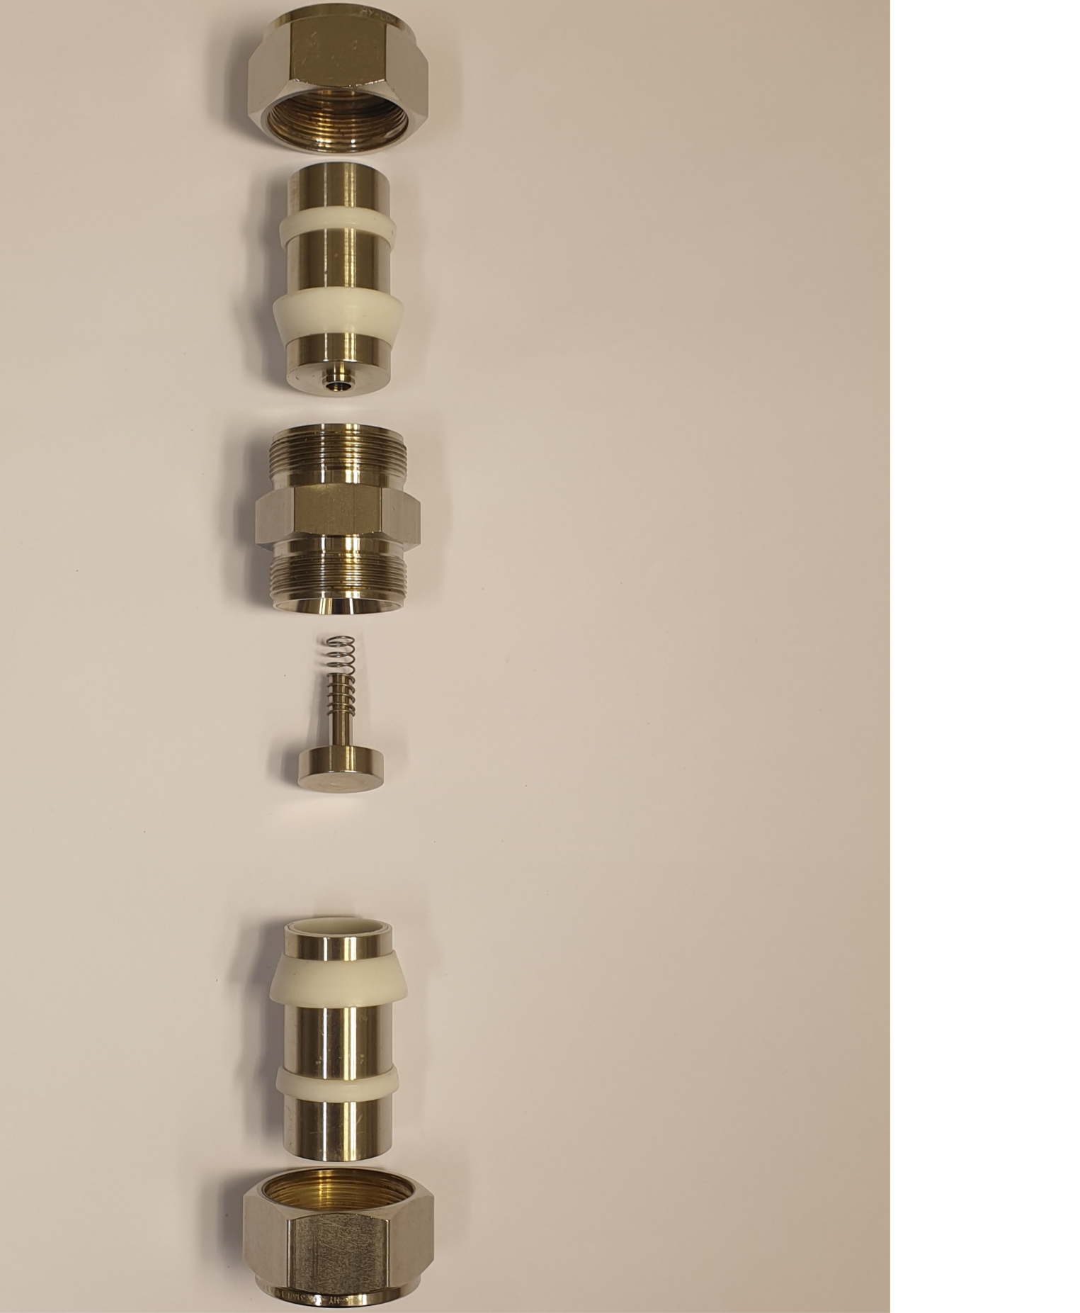
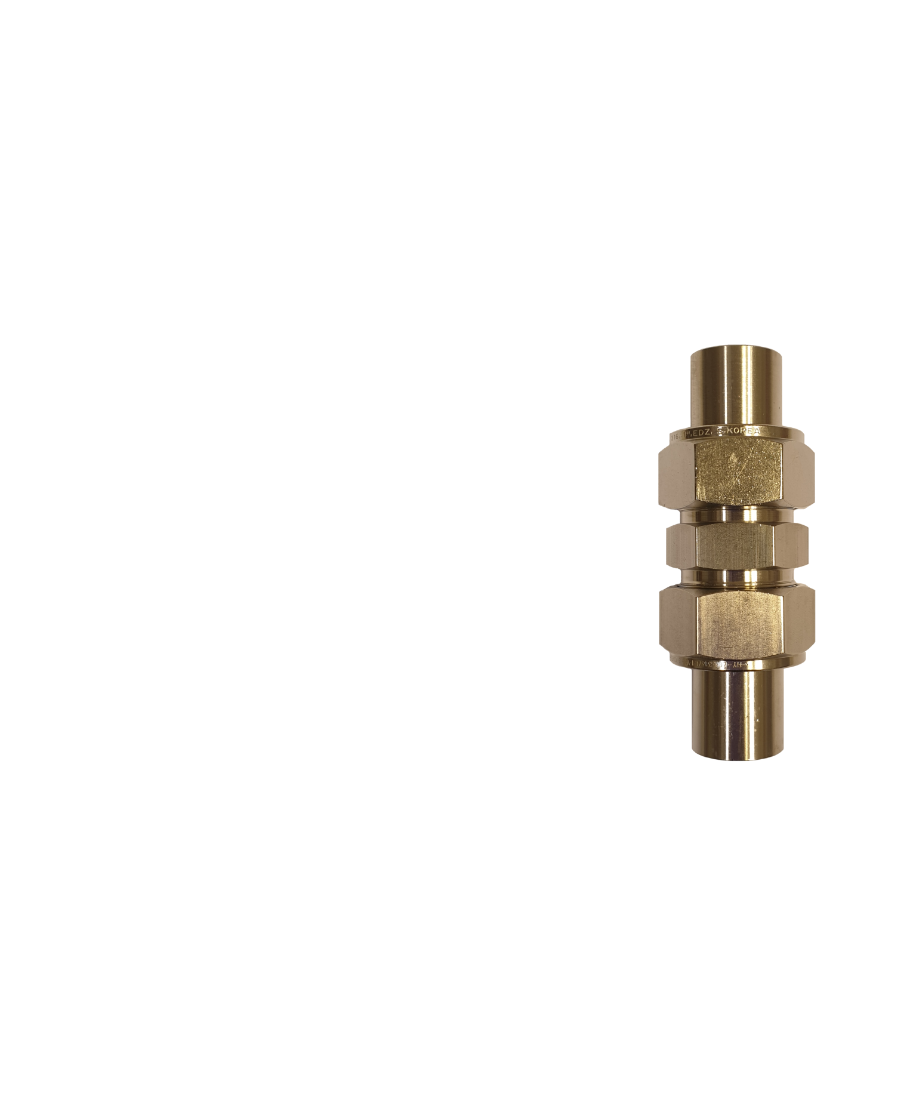

The I-cell
Nut
Metal rod
Sealing
rings
Main body
Spring
Spacer
Li
Separator
Cu

Slide 40
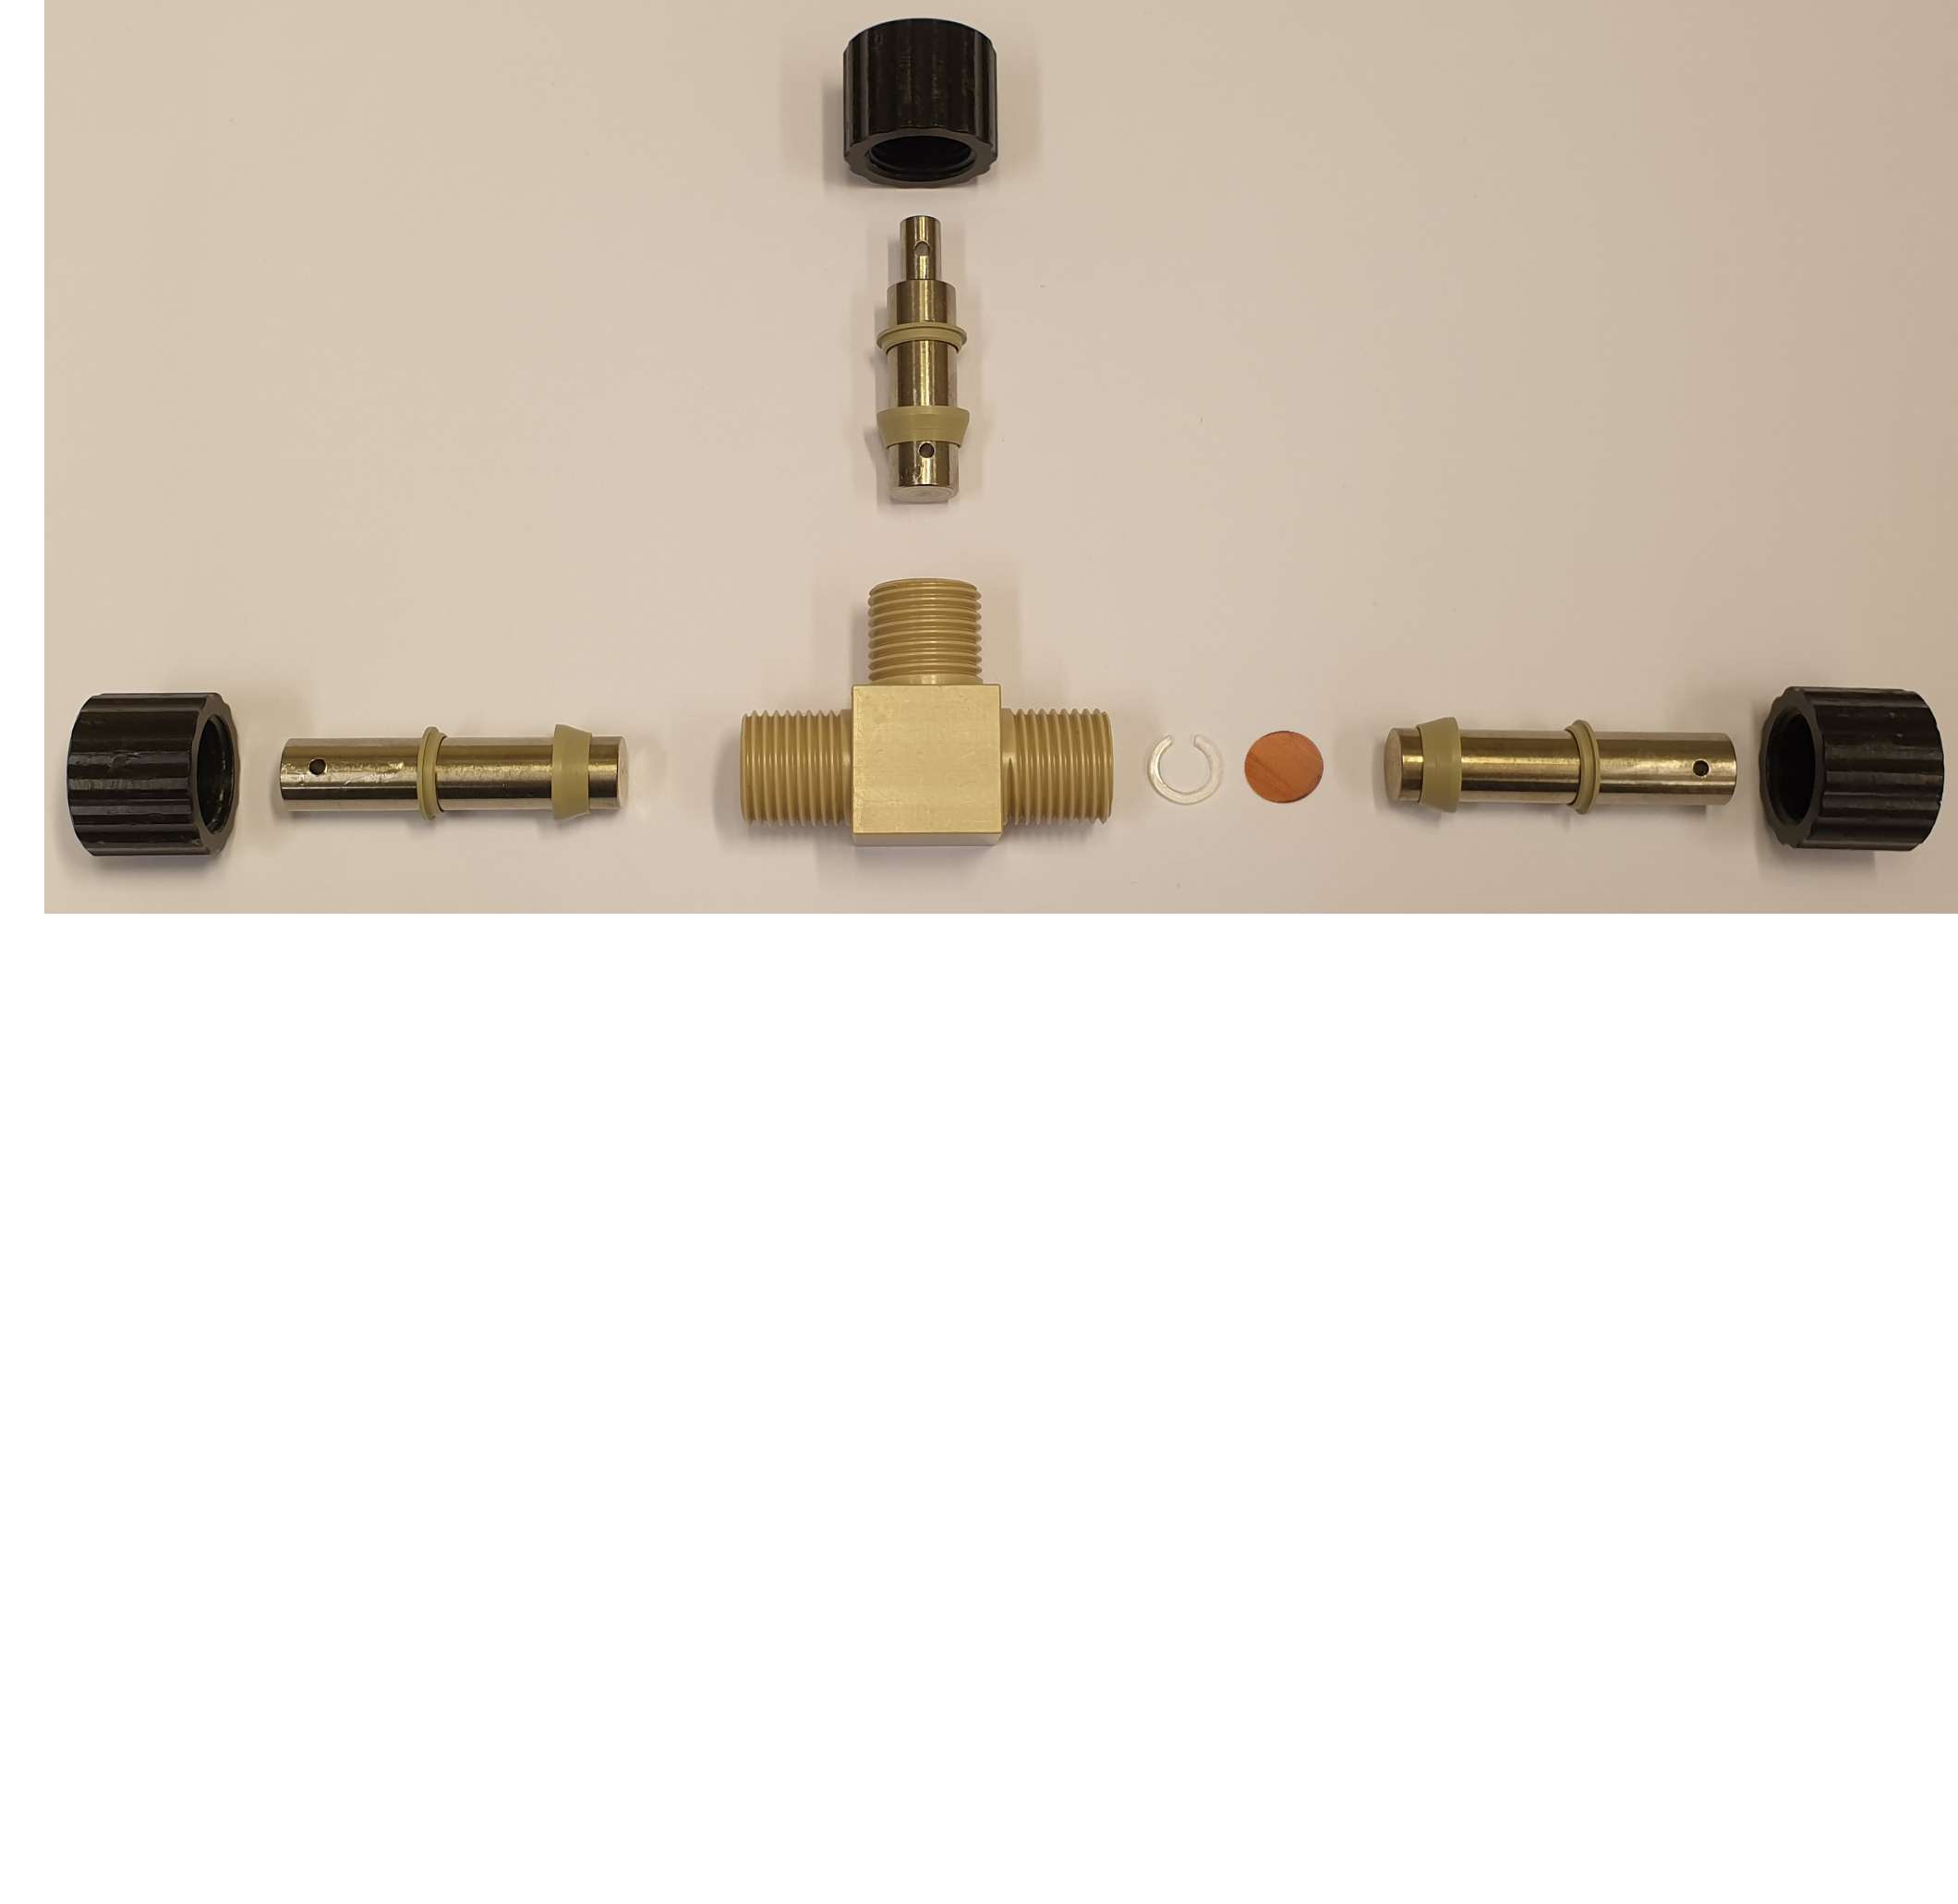

The T-cell
Nut
Metal rod
Sealing rings
Li
Main body
Spacer
Cu

Slide 41
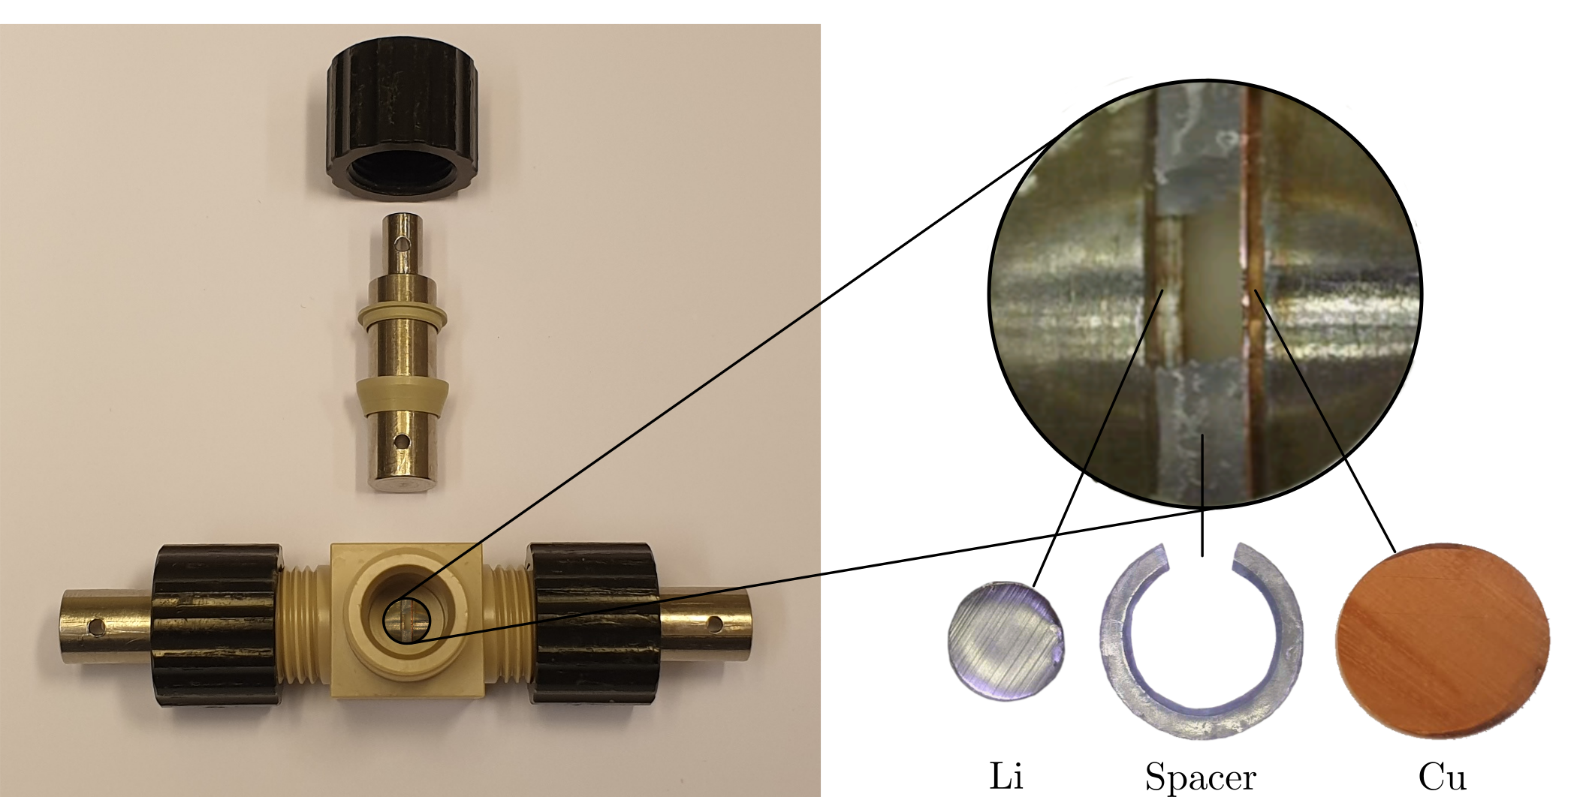
The T-cell

Slide 42
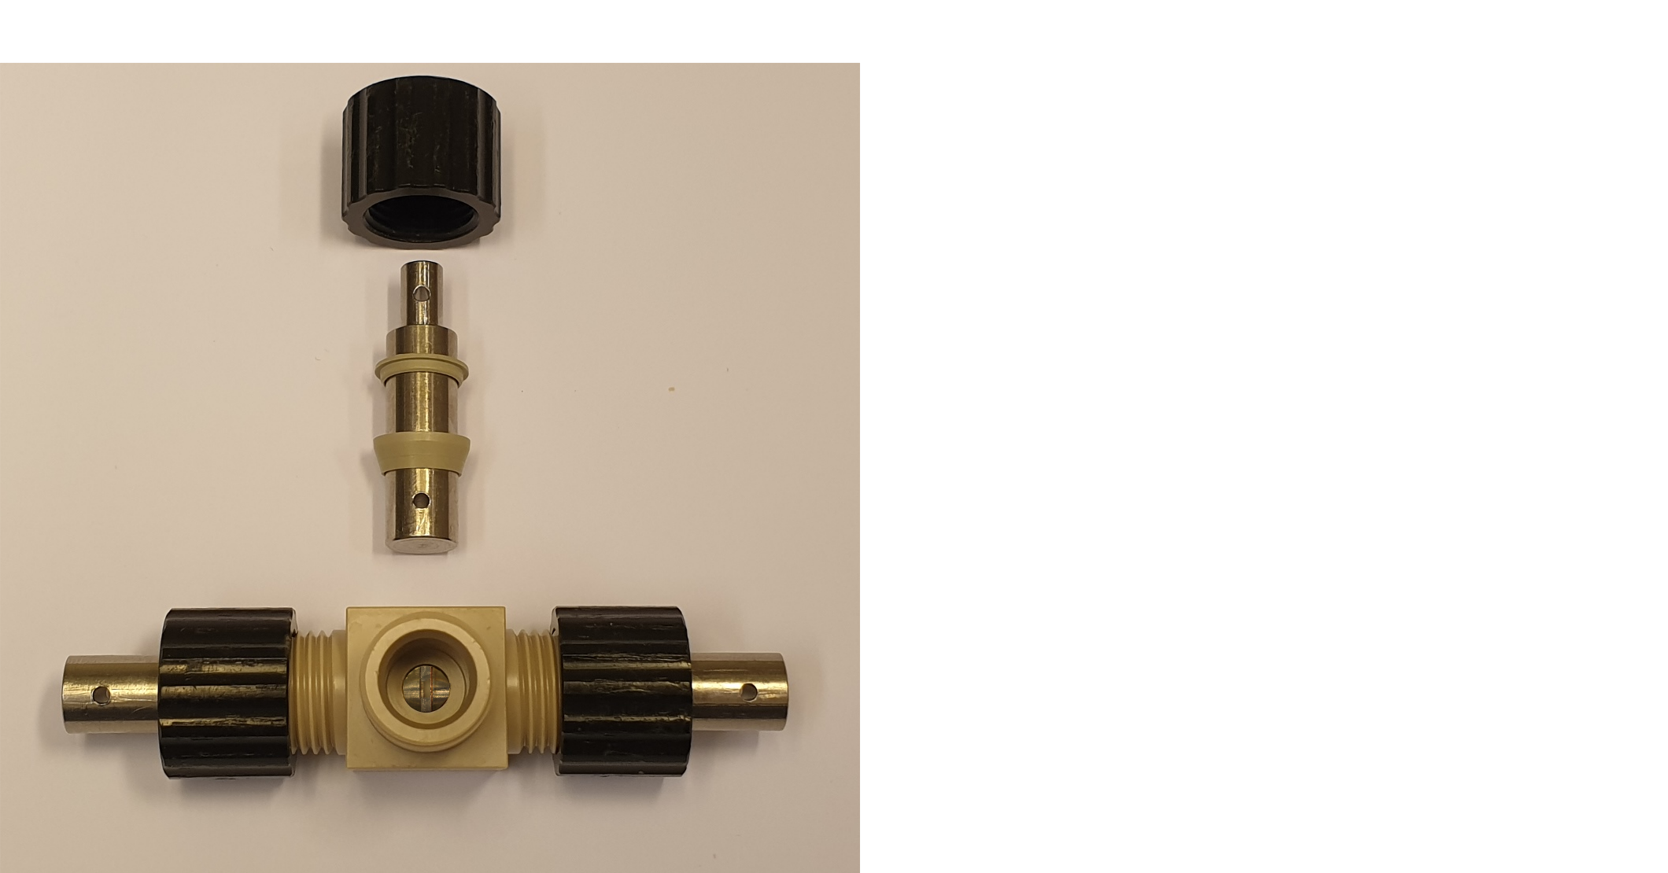
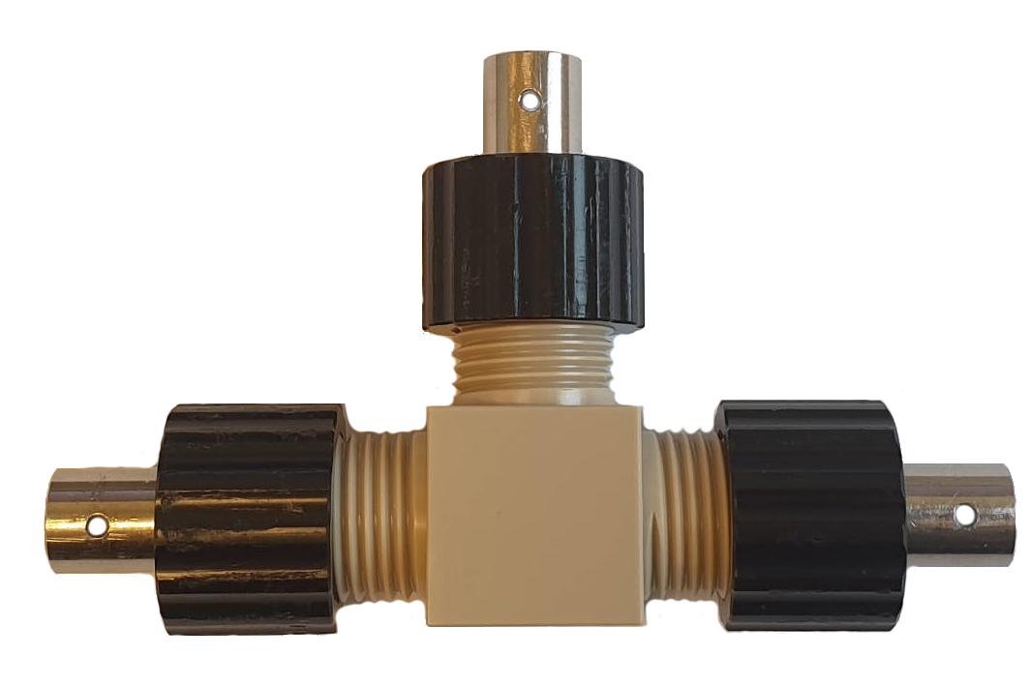
The T-cell

Slide 43
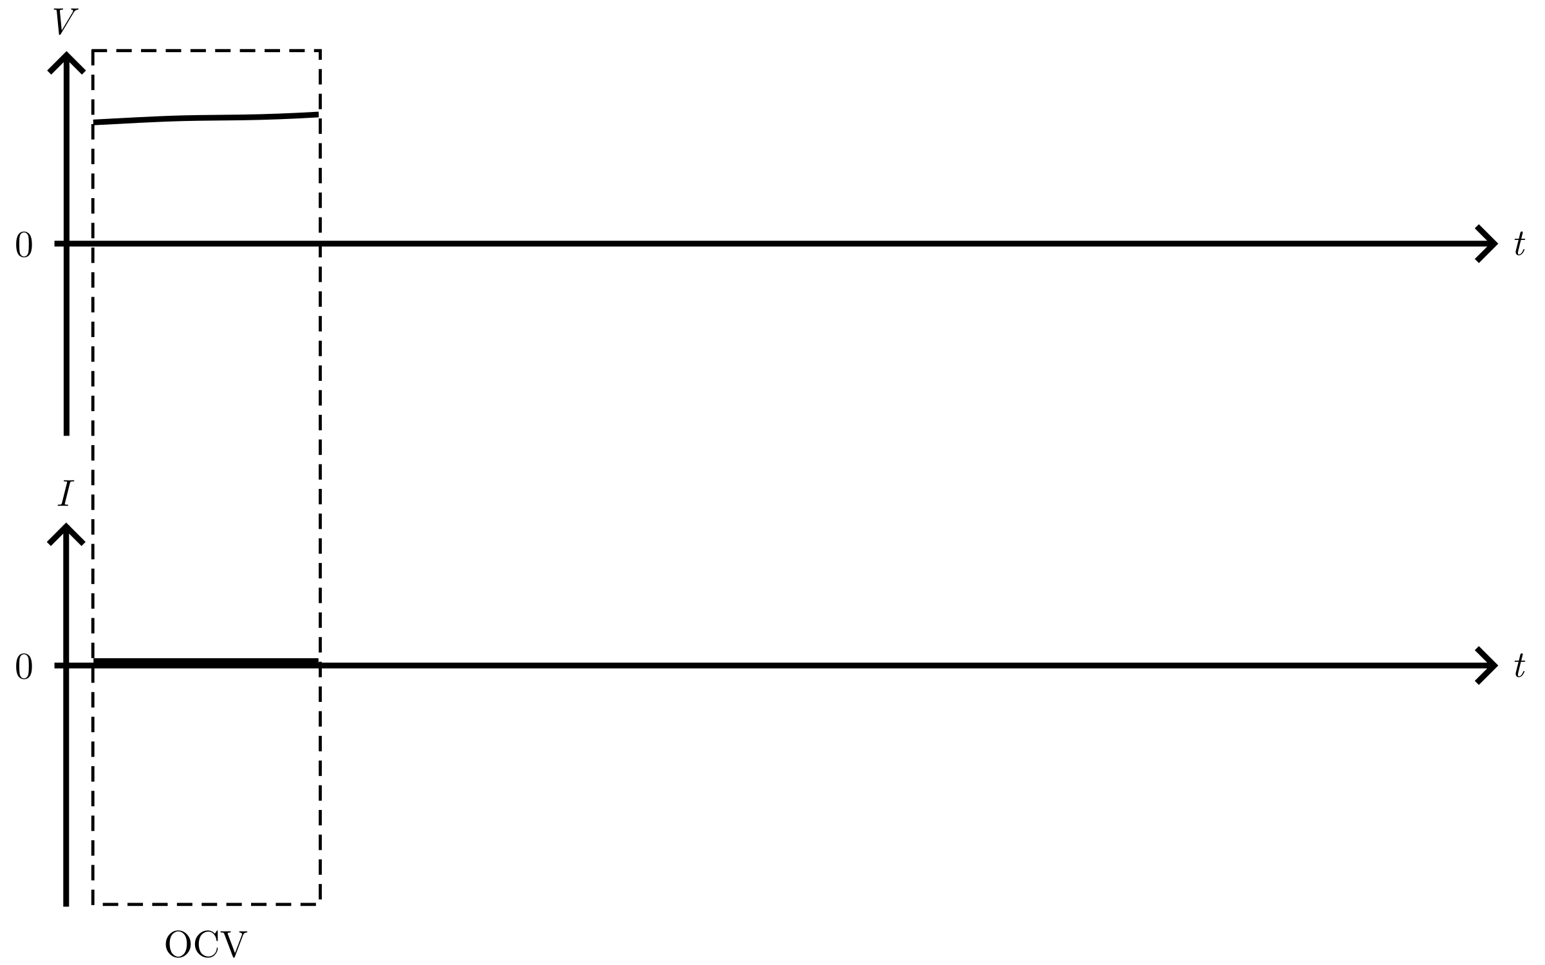
Deposition protocol

Slide 44
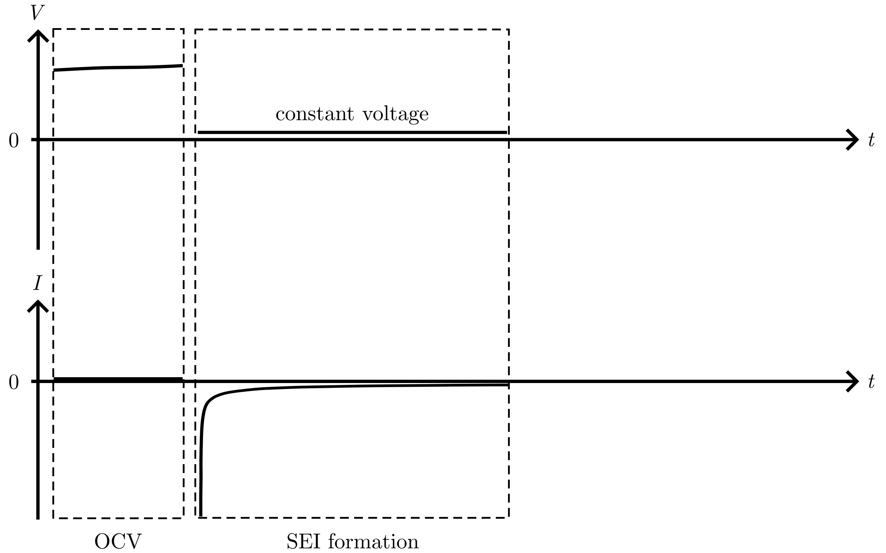
Deposition protocol

Slide 45
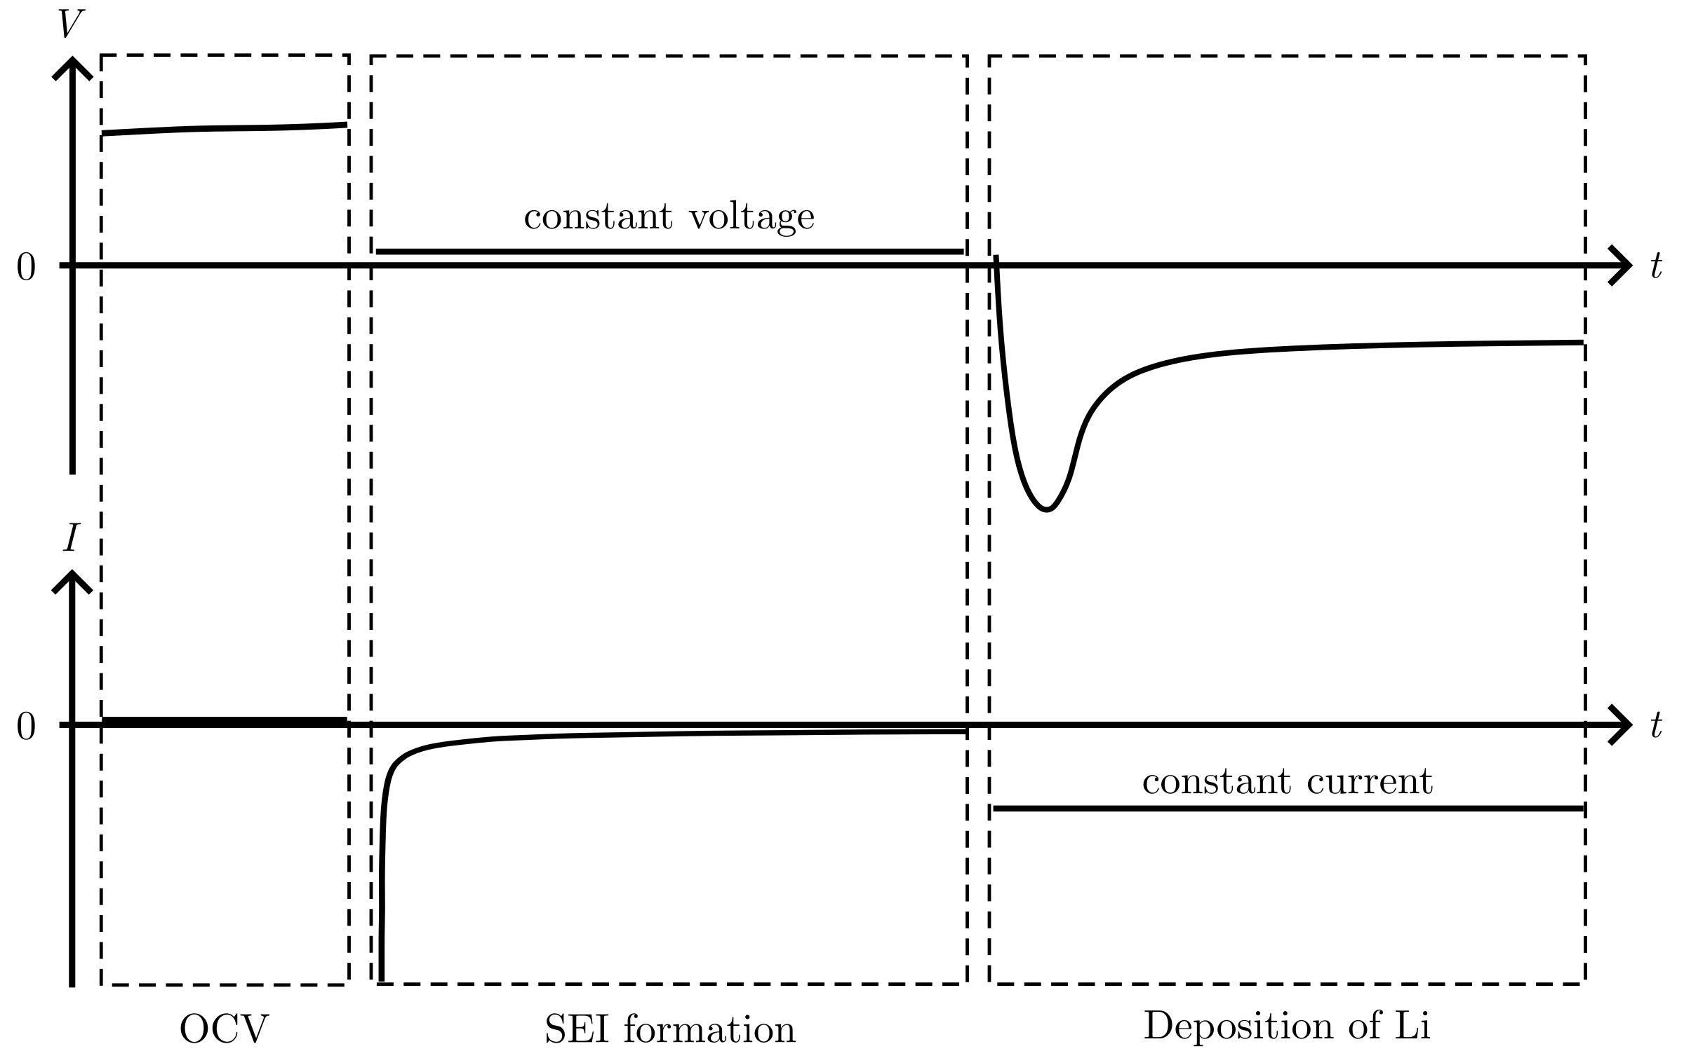
Deposition protocol

Slide 46
Deposition protocol: σ

Slide 47
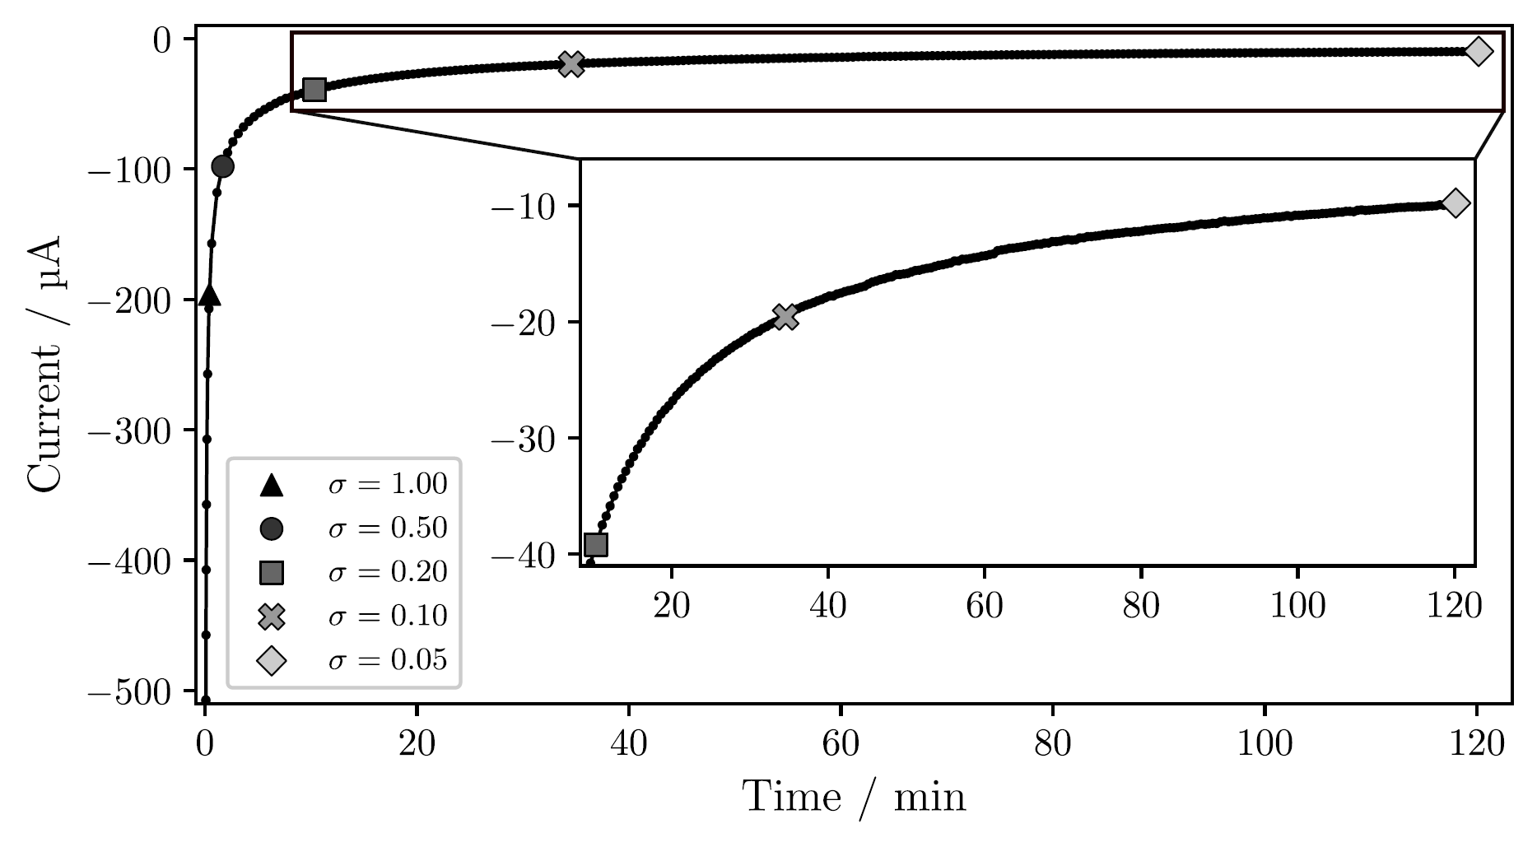
Passivation of the Cu surface
Notes:
T-cell, Jdeposition = 1 mAh/cm²
Time increase for lower sigma: 2 min for 0.50, 2 hour for 0.05, over 25 hours for 0.01

Slide 48
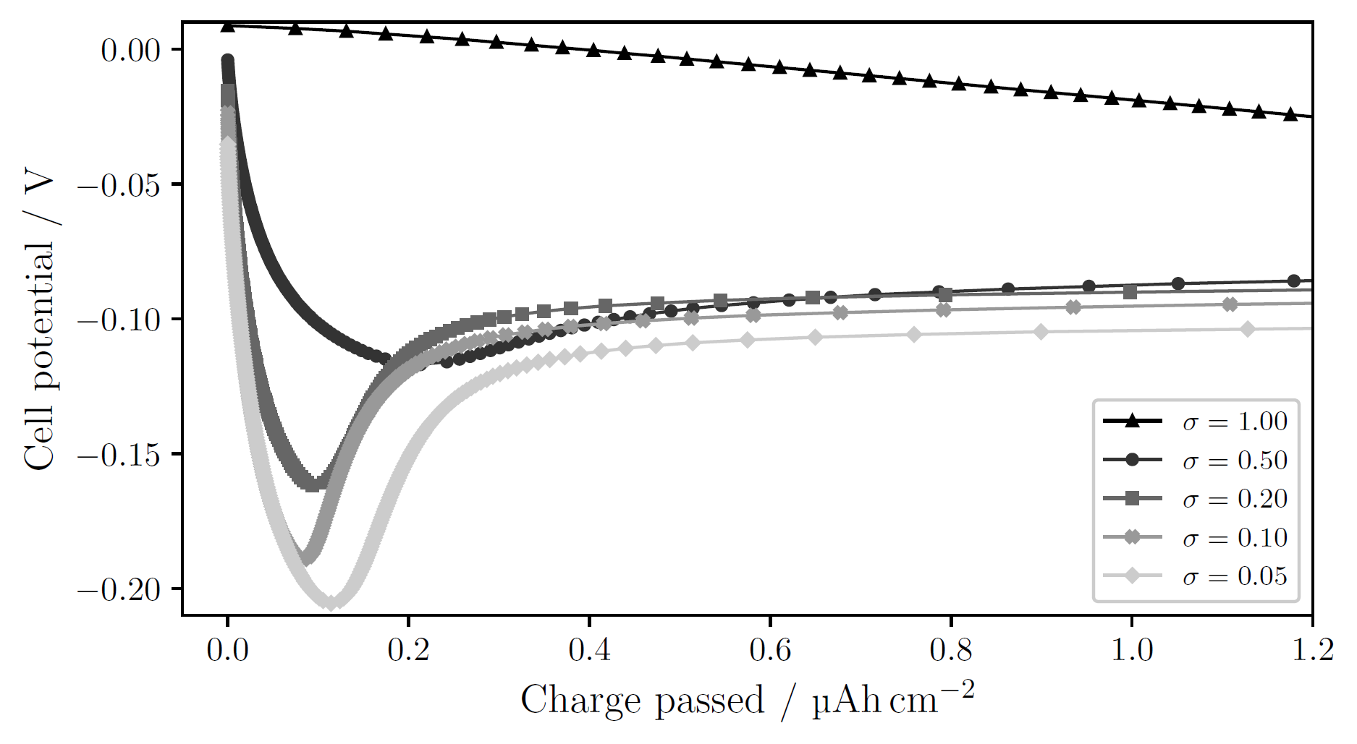
Passivation of the Cu surface
Notes:
T-cell, 1 mAh/cm²
sigma=1.00: no obvious nucleation; side reactions large enough to drive current without need for nucleation
Decreasing sigma → clearer deposition peak at higher overpotential
Larger overpotential → smaller nuclei, larger N → many sites for continued growth, lowering the necessity for further nucleation. Other words: more instantaneous nucleation (all nuclei form at the start and then they only grow).
Opposed to progressive nucleation, where nuclei continue to form as other grow

Slide 49
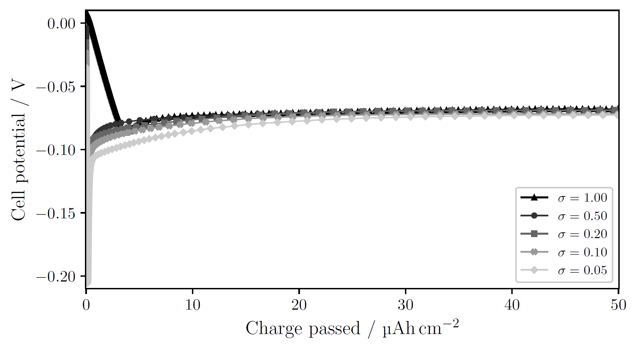
Passivation of the Cu surface larger charge passed
Notes:
T-cell, 1 mAh/cm²
sigma=1.00: no obvious nucleation; side reactions large enough to drive current without need for nucleation
Decreasing sigma → clearer deposition peak at higher overpotential
Larger overpotential → smaller nuclei, larger N → many sites for continued growth, lowering the necessity for further nucleation. Other words: more instantaneous nucleation (all nuclei form at the start and then they only grow).
Opposed to progressive nucleation, where nuclei continue to form as other grow

Slide 50
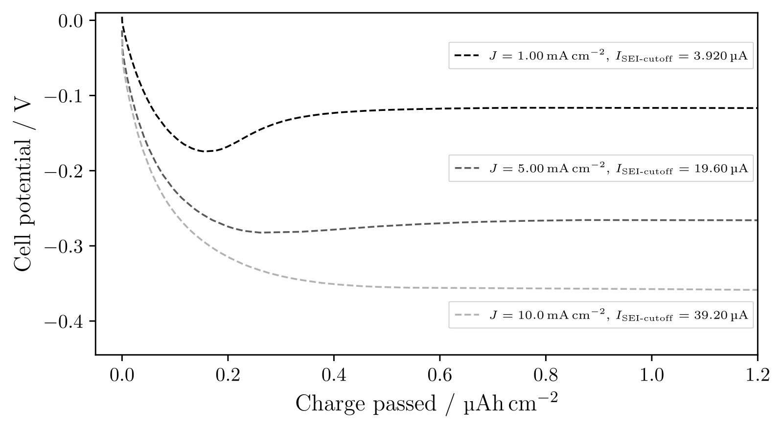
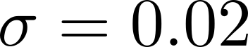
Deposition current

Slide 51
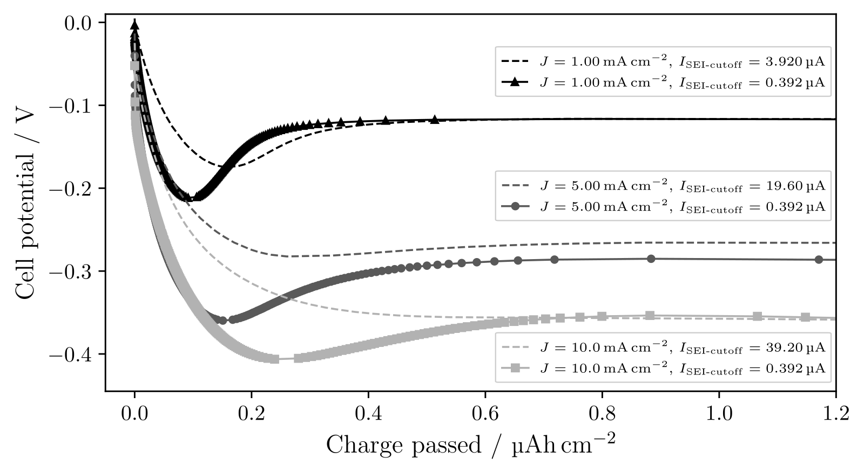
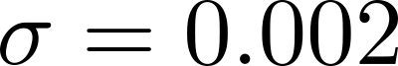
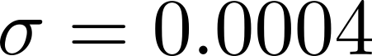
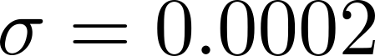
Deposition current with more passivation

Slide 52
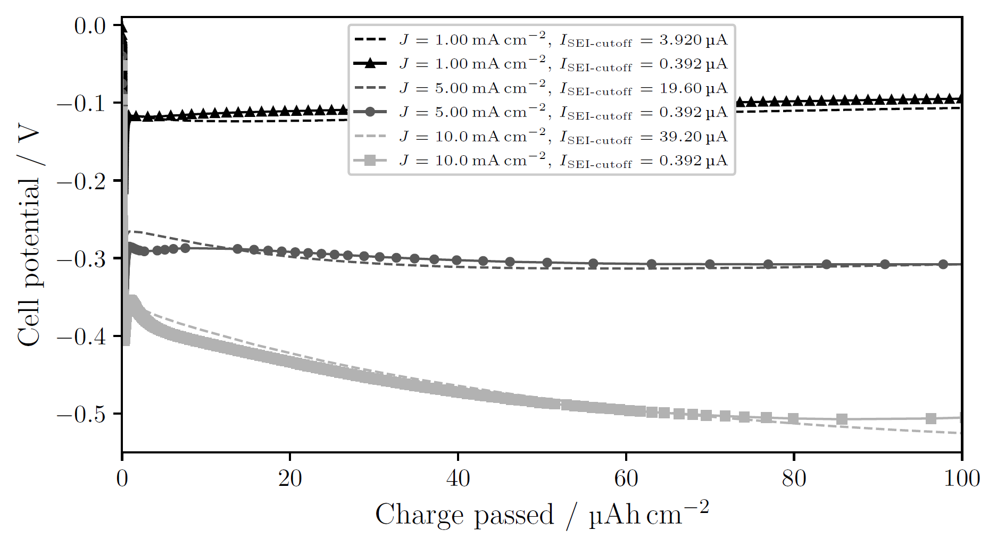
Deposition current with more passivation larger charge passed

Slide 53
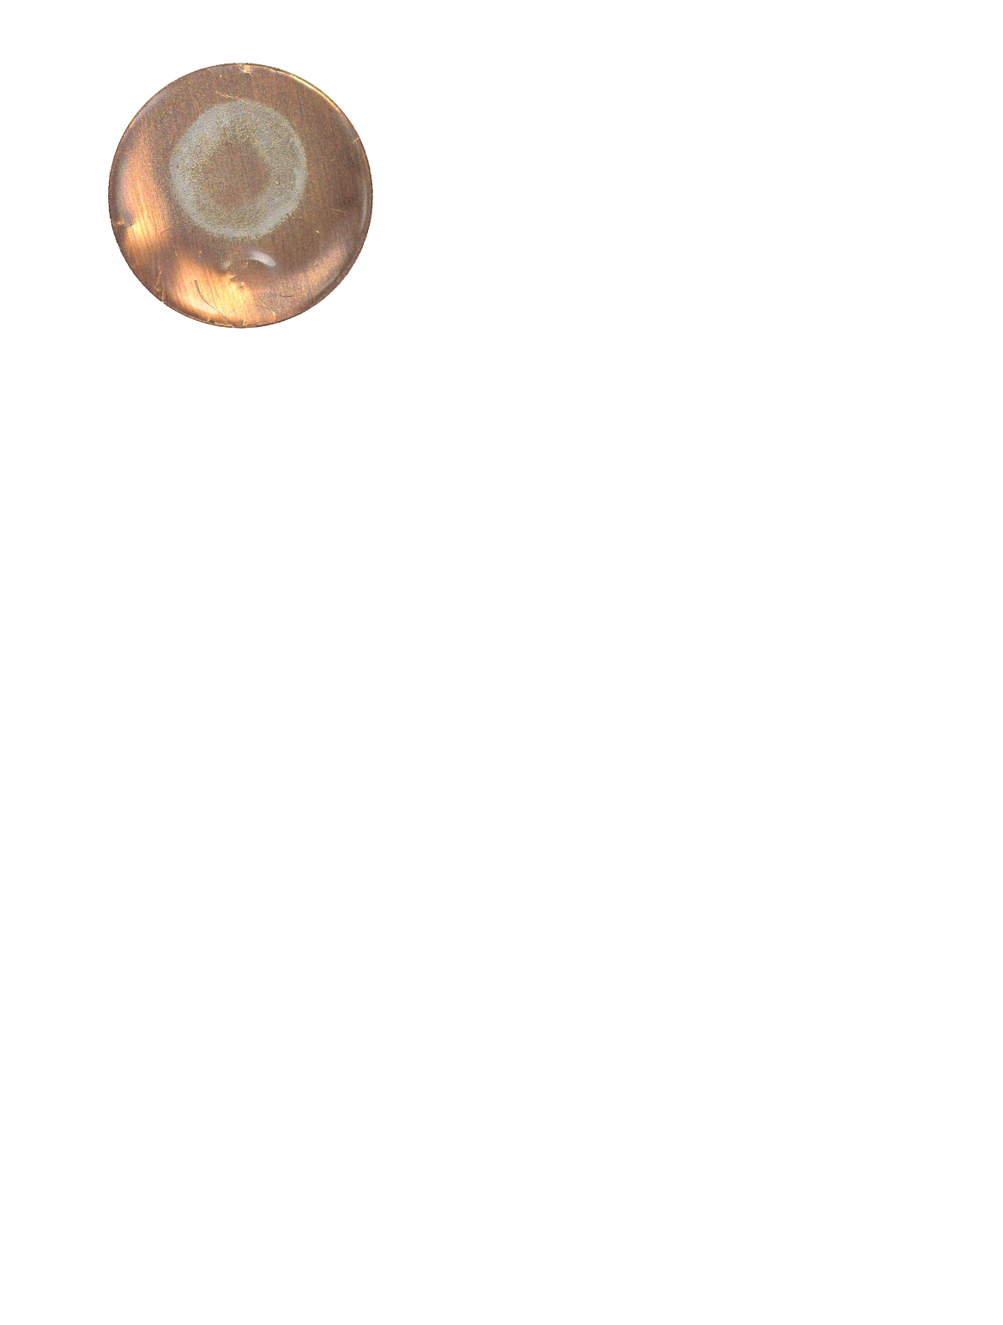
Pressure effects

Slide 54
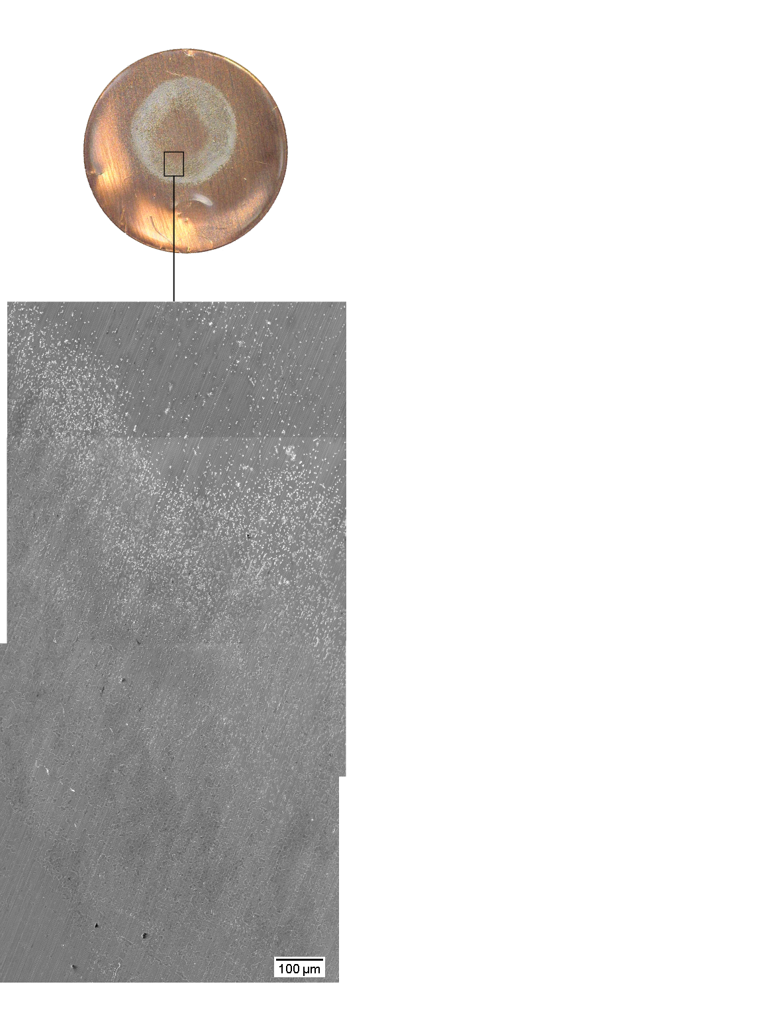
Pressure effects

Slide 55
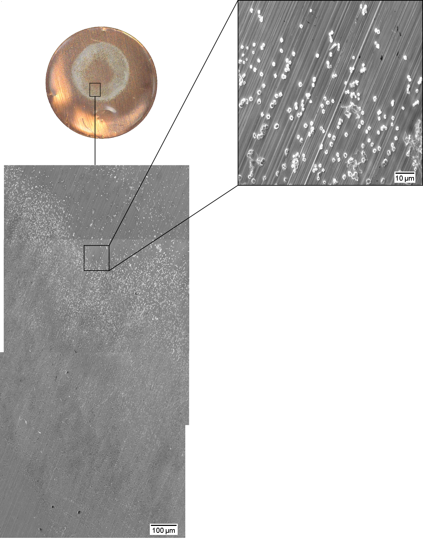
Pressure effects

Slide 56

Pressure effects

Slide 57

Pressure effects

Slide 58
Pressure effects
2r = 1 µm
2r = 2 µm to 3 µm
2r ≥ 4 µm

Slide 59
Pressure effects
2r = 1 µm
N = 0.024 nuclei/µm²
2r = 2 µm to 3 µm
N = 0.022 nuclei/µm²
2r ≥ 4 µm
N = 0.016 nuclei/µm²

Slide 60
Pressure effects
2r = 1 µm
N = 0.024 nuclei/µm²
2r = 2 µm to 3 µm
N = 0.022 nuclei/µm²
2r ≥ 4 µm
N = 0.016 nuclei/µm²

Slide 61

Pressure effects

Slide 62

Pressure effects

Slide 63

Pressure effects

Slide 64

Pressure effects

Slide 65

Pressure effects

Slide 66


Pressure effects

Slide 67

Pressure effects

Slide 68

Pressure effects

Slide 69
Conclusions
More instantaneous or more progressive nucleation depends on the current ratio of the side reactions and the deposition (σ).
The nuclei distribution (r and N) is influenced by the degree of passivation since that changes the nucleation peak (η).
Uniform pressure between the electrodes is essential to achieve uniform deposition.

Slide 70
Thank you for listening!

Slide 71
//Lägg in fler plots här efter på större charge och andra figurer som Isak kanske kommenterar

Slide 72
Electrochemical deposition of lithium on copper
Gottfrid Olsson
2024-05-29

